Slide 1


Human-Centered AI
for South Florida Waters
Ahmed S. Elshall^{1,2,3} and Michael Alvear¹
¹ U.A. Whitaker College of Engineering, FGCU
² The Water School, FGCU
³ Dendritic: A Human-Centered AI and Data Science Institute, FGCU
The 2026 FGCU AI Summer Academy
Wednesday, May 6, 2026
Notes:
Good morning everyone, and thank you for joining us for the 2026 FGCU AI Summer Academy.
My name is Ahmed Elshall, and I am joined in this presentation by Michael Alvear. We are both affiliated with WCE
and this work is also connected to Dendritic, FGCU’s Human-Centered AI and Data Science Institute.
Today’s seminar is titled Human-Centered AI for South Florida Waters.
The central idea of this talk is that artificial intelligence should not be viewed only as a way to build more accurate algorithms.
In environmental and water systems, AI becomes most useful when it helps people interpret complex data, understand uncertainty, and make better-informed decisions.
South Florida is a particularly important place to have this conversation. Our water systems are deeply connected to
climate,
ecosystems,
public health, infrastructure, and community well-being.
They are also data-rich but decision-complex.
In this presentation, we will look at two related directions.
First, we will discuss how machine learning and deep learning can support harmful algal bloom forecasting and screening.
Then, we will shift to groundwater resilience and show how large language models may help people access and understand complex environmental model outputs.
The broader question throughout the talk is this:
how can AI support water decisions while keeping people, uncertainty, and responsible use at the center?

Slide 2

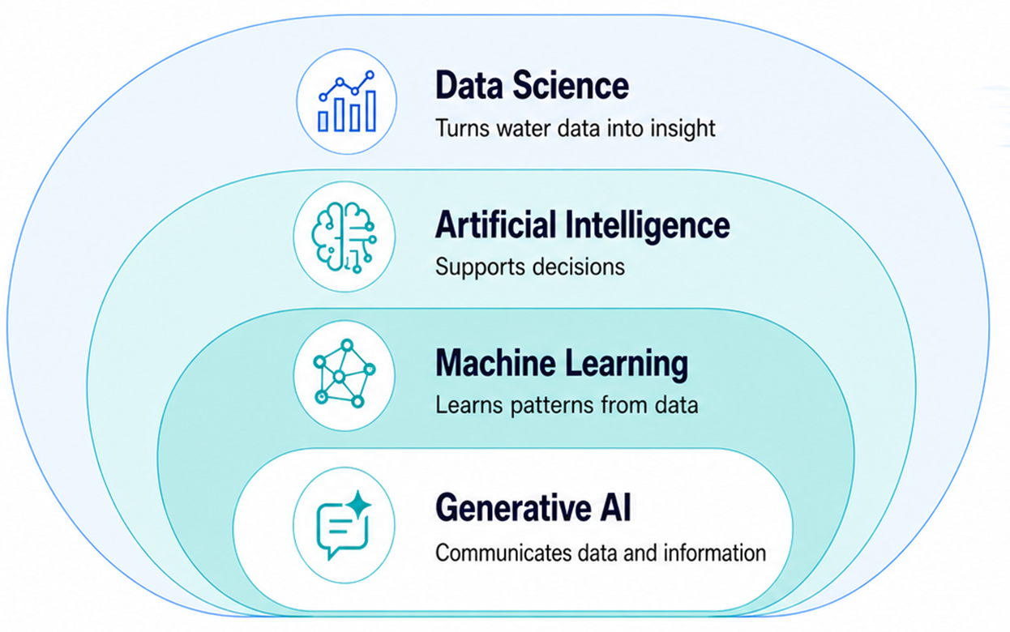
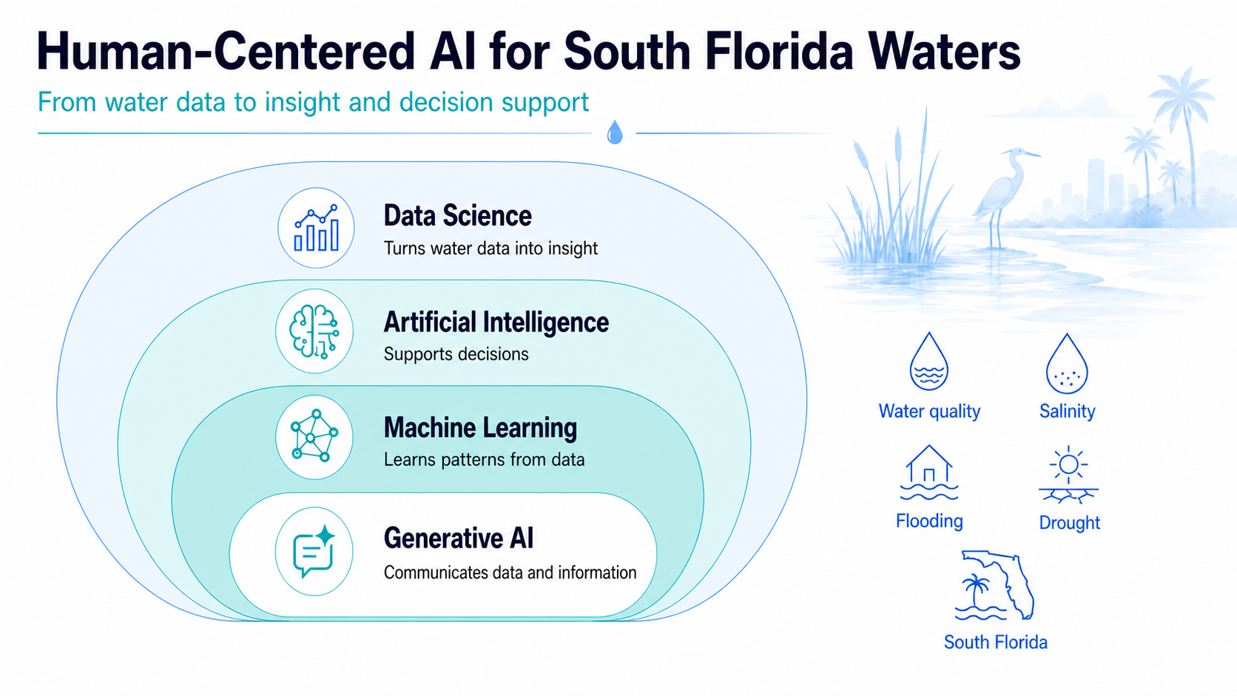
Human-Centered AI for South Florida Waters
From water data to insight and decision support
Human-centered AI asks: Who uses data? Who is affected? What remains uncertain?
Notes:
Human-centered AI is not just about better algorithms;
It is about designing tools that help people make water decisions under uncertainty.
Human-centered AI asks: Who uses data? Who is affected? What uncertainty remains and how to communicate uncertainty

Slide 3
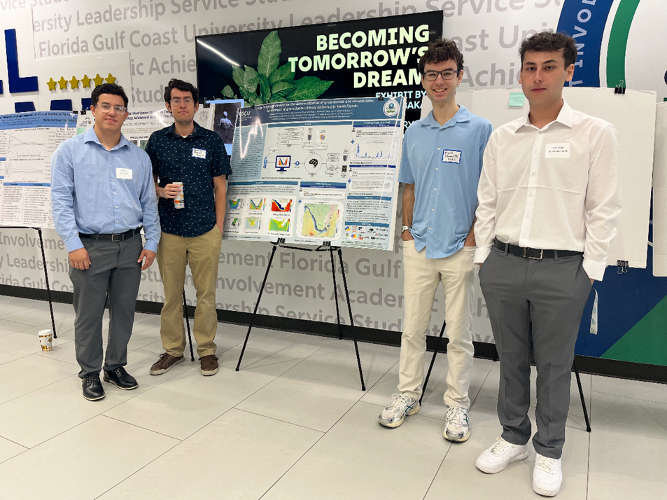






Acknowledgements
Matthew Duus
Civil Engineering, WCE
Nathan Hewitt Graduate Student, The Water School
Group of Michael Alvear, Luis Cabrera, Mark Schwartz, and Christopher Smith, Software Engineering, WCE
Group of Victor Morales Blanco, Daniel Krutky and Peter Nguyen, Software Engineering, WCE
Mewcha A. Gebremedhin Environmental Engineering, WCE

Slide 4
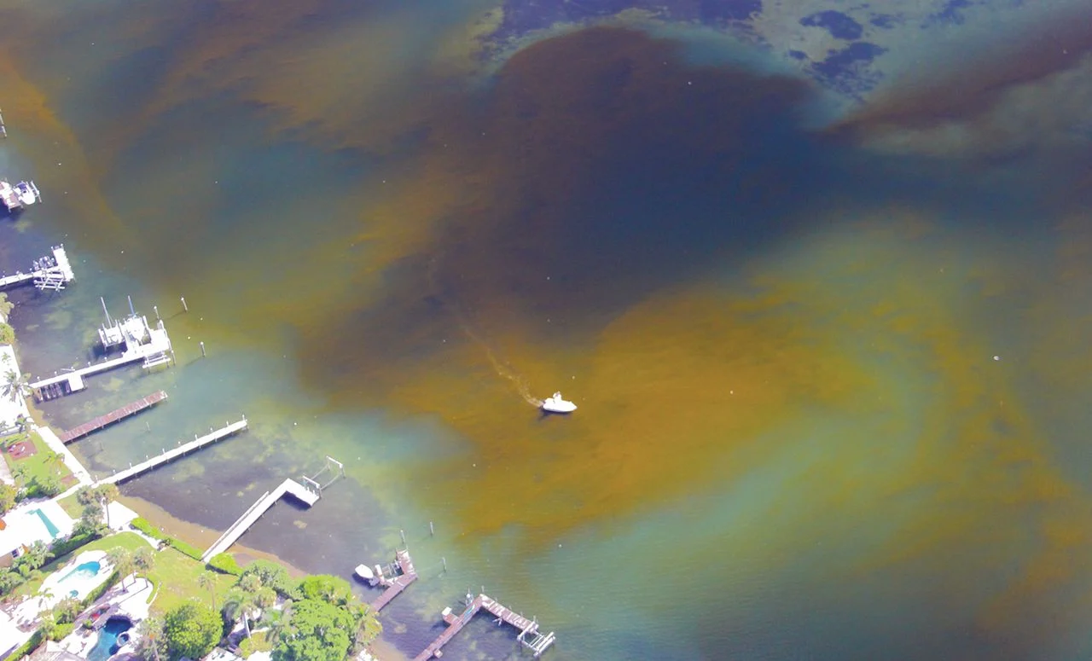
Red tide projection is challenging as multiple climate drivers can alter the occurrence, intensity, and toxicity of red tides
Notes:
What is red tides?
These are harmful algae blooms that occurs worldwide.
Red tide here in Florida is due to the increase of concertation of Karenia brevis, single-celled, marine dinoflagellate,
More importantly they produce potent neurotoxins collectively called brevetoxins, which cause stomach and neurological problems for marine organisms, seabirds and humans.
Talk about tourism and respiratory illnesses and shellfish poisoning here
What causes red tides?
The exact factors of red tide are not well understood
Karenia brevis is a mixotrophic organism.
This means that Karenia brevis can assimilate inorganic and organic carbon using the combination of heterotrophic and autotrophic modes,
and because of these modes together, it is not limited by nutrients, but that does mean that nutrients are not important.
Because nutrients can be important for other phytoplankton groups that Karenia brevis from a complex ecology.
In that regard African Sahara dust is an important driver of red tide, which supply missing micronutrients such as iron
We thought we might be able to use an ESM to study and project red tides in a changing climate due to these global teleconnection like
African Sahara Dust,
and Gulf stream.
The Current situation of red tides and HABs in general is fairly well understood.
As climate driven changes in marine ecosystems are becoming substantial, according to the IPCC report, HABs has increased in coastal areas since early1980s in response to
warming,
deoxygenation,
and eutrophication (the over-enrichment of water by nutrients (mainly nitrogen and phosphorus)
A few studies show increase in frequency of red tide blooms in the GoM since the mid-1990s.
But the one-million-dollar question that we are trying to answer: how would red tides change with a changing climate?
This is in terms of red tide frequency, intensity, and toxicity
In the GoM will red tides become worth in South Florida, or it is going to move to North Florida, Louisiana, and Texas for example? We do not know.
Only very few studies have attempted to project red tides in a changing climate, which is an indication of the difficulty of this important task
So we thought about using an ESM for this challenging, but important task of projecting red tides and HABs in general

Slide 5

Projecting red tides online by an Earth system model (ESM) has potential, yet now it is only plausible offline using ESM outputs
Notes:
The idea of using an ESM
We thought we might be able to use an ESM to study and project red tides in a changing climate because red tides is
at the interface of everything (biosphere, geosphere, hydrosphere, and atmosphere)
with global teleconnection like African Sahara Dust, and Gulf stream.
I will focus in this presentation on the Gulf stream impact on red tides.
Red tide modeling requires the simulation of
land to ocean nutrient and sediment transport,
African Sahara dust that supply micronutrients for other phytoplankton such as Trichodesmium
ocean biogeochemical reactions,
tropical cyclones as red tide is often observed after these events
wind speed and direction as red tides general grows far off-shore and is transported near the coast by wind
Ocean current such as Loop Current that control upwelling that provides nutrients, and retention time required for the bloom to grow
Modeling red tide online with an ESM can be possible in the future with the following CMIP phases
ESM would function as an ecosystem-based model for simulating red tides and other phytoplankton groups
Going beyond a global ocean circulation model or climate model that couples the ocean to the atmosphere, to an ESM with increased coupling and model fidelity by including more processes
Talk about E3SM, the ongoing development of EMS is in the direction of coupling the atmosphere, biosphere, hydrosphere, geosphere, and human activities
Approaches for modeling red tide using an ESM
Beside using the EMS as an ecosystem-based model for simulating red tides online, which can be difficult
Another approach is to use the outputs of an ESM as inputs
Inputs for mechanistic models (Lagrangian or an individual-based model)
phenomenological model such as a machine learning model or statistical model
We need an ensemble
For this second approach of using the outputs of an ESM to develop a machine learning model for example,
we need to develop an ensemble of models and for this tasks the HR-models of CMIP6 can be very useful in simulating regional phenomenon that are not possible with the SR-ESM
Allow me to show you

Slide 6

A high resolution-ESM can reproduce regional phenomena like Loop Current, a warm ocean current that drives red tides
Reanalysis Data
Loop Current South
March 2010
Reanalysis Data
Loop Current North
June 2010
High Resolution-ESM
Loop Current North
June 2010
Low Resolution-ESM
Loop Current North
June 2010
CMEMS global-reanalysis-phy-001–030 (8 km)
CMEMS global-reanalysis-phy-001–030 (8 km)
HadGEM3-GC3-MM (25 km)
E3SM (30-60 km)
Notes:
Loop current which is part of the gulf stream is a warm ocean current that circulate in the GoM.
HR-ESM can simulate LC, and SR-ESM cannot:
HR-ESM with eddy-permitting grids, which can resolves mesoscale eddies can simulate the Loop Current (do not require ocean eddy flux parameterization)
Versus LR-ESM with eddy closure (EC) grid with global parametrization of mesoscale eddies,
rather than explicitly resolving mesoscale eddies and boundary currents
cannot to resolve the regional spatial phenomena of interest such as Loop Current
Why resolving and simulating Loop Current is important:
This is because Loop Current in the North position is a pre-request for red tides to occur
Allow me to show you

Slide 7
A high resolution-ESM can reproduce regional phenomena like Loop Current, a warm ocean current that drives red tides
LC-S Ratio 0.27
LC-S Ratio 0.23
Notes:
Explain LC-S and LC-N and blooms
Explain LC-S no bloom
LC-N there can be bloom or no bloom
An ensemble that can reproduce the re-analysis data needs to be application specific
There are models than can reproduce SSH better than other models, but that is not a very useful metric
We need a metric that is application specific
We also need to use prior information: From prior information we know that SR-models with eddy closure cannot reproduce LC and we need MR/HR models with eddy resolving, we know this from literature
That is easy to figure out, and then for the remaining models we can do one of to things.
To make the ensemble application specific we need to do pre-screening
We can do model weighting. For example, optimal model weighting will for the ensemble to fit the data by assigning a weight for each model, this has a big drawback as I will show you later
We can also do subset selection to choose representative and/or skillful models, as I will show you next
We can also do weighting and subset selection together
Anyway, to do subset selection or to make model weighting meaningful, we need pre-screening as I will show you now
Additional information for Q&A
There are two views, weighting and subset selection:
In subset selection, a subset of models, which have better performance in a set of models, are selected as ensemble members.
Accordingly, a question that often arises in multi-model combination is whether the original set of models should be screened such that “poor” models are excluded before model combination?
One argument is that combining all “robust” and “poor” models to form an ensemble is an intuitive solution that has advantage over subset selection that uses the best performing models
Because while the “poor” model can be useless by itself, it is useful when combined with other models due to error cancellation
Another justification is that no small set of models can represent the full range of possibilities
On the other hand, it has been argued that the objective of subset selection is to create an ensemble of well chosen that will have the characteristics that reflect the full ensemble.

Slide 8
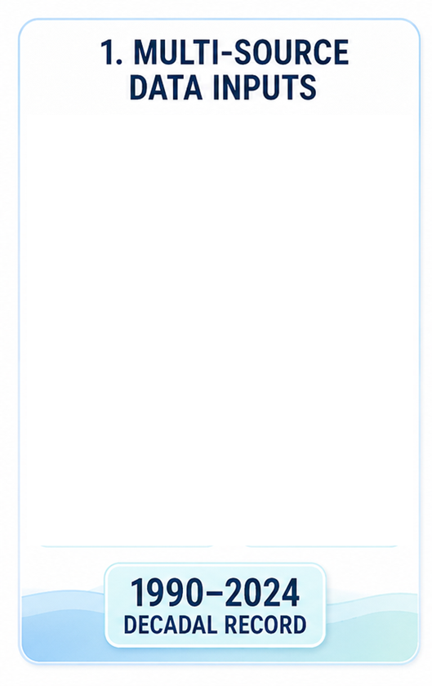
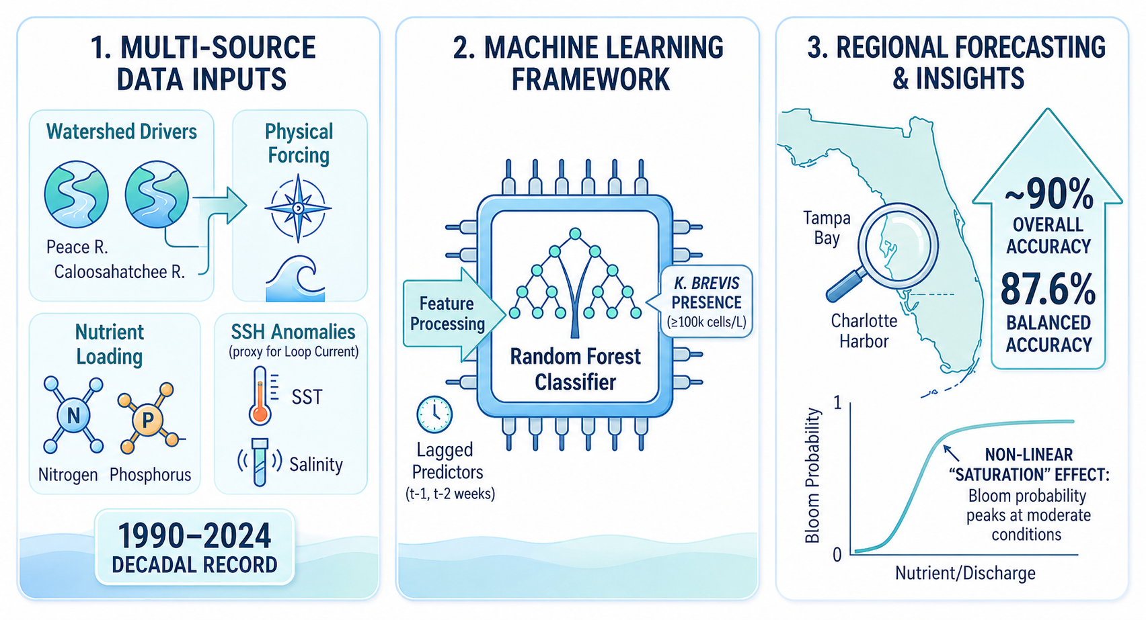
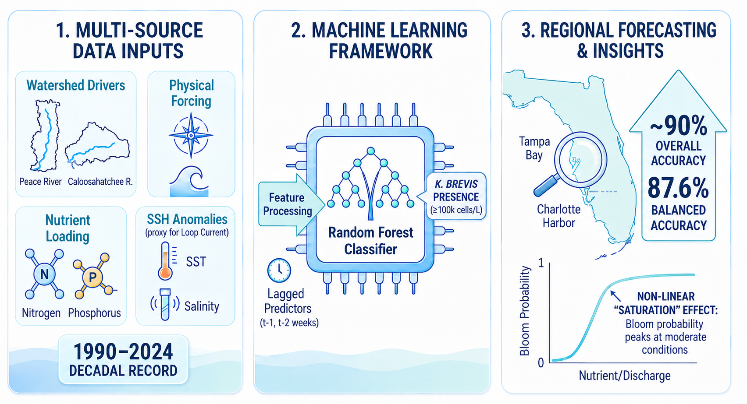
Loop Current is just on main driver among other physical and environmental drivers

Slide 9
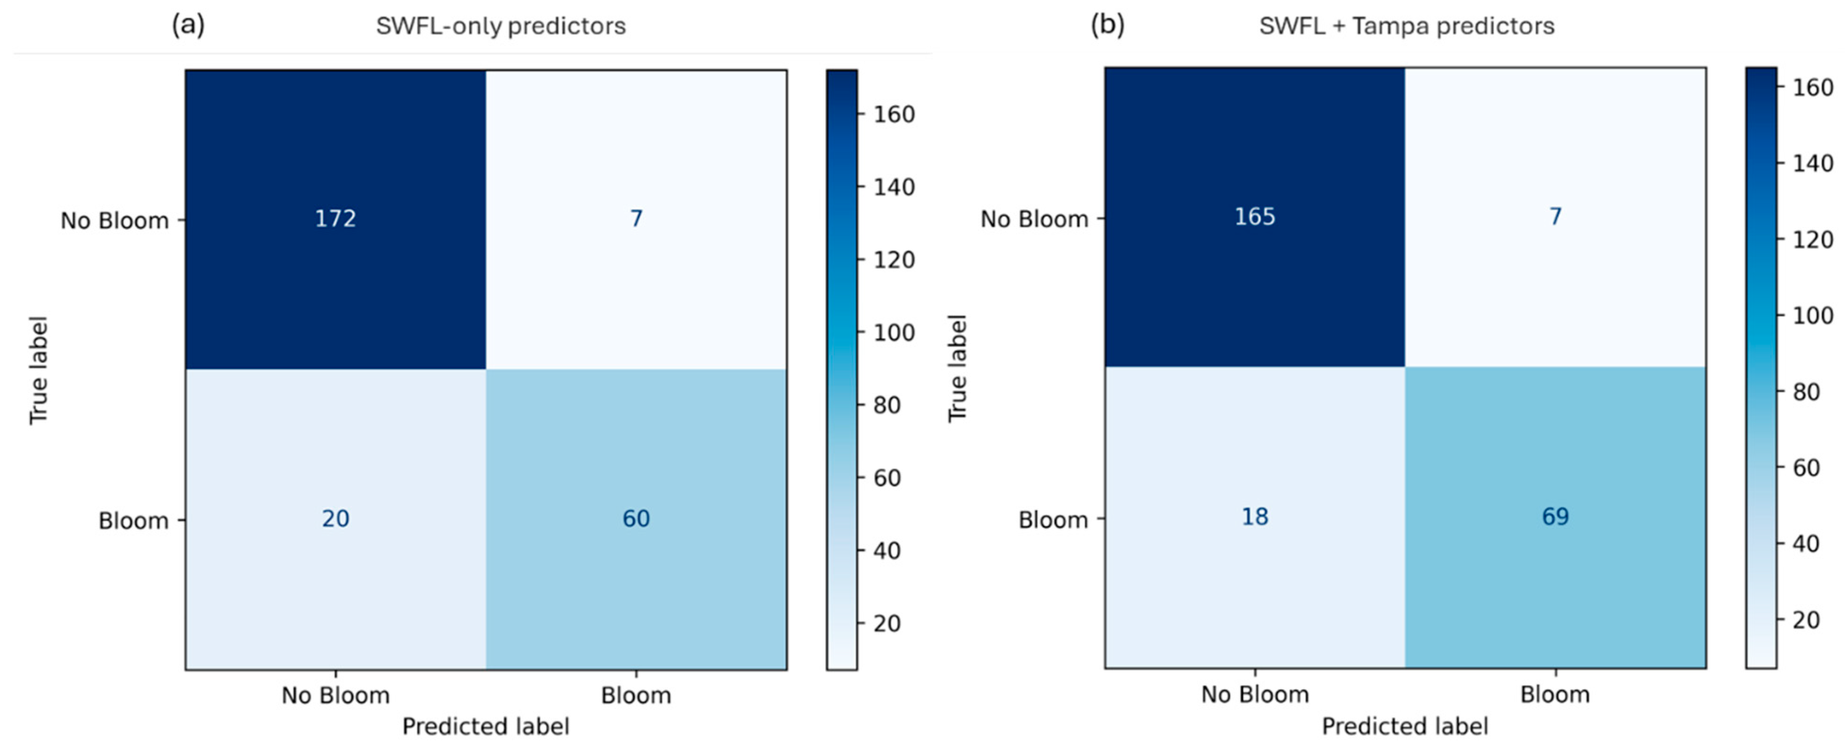
Random Forest classifier trained on weekly data (1993-2018, tested on independent years (2019-2024) shows high accuracy
balanced accuracy 85.5%
balanced accuracy 87.6%
Notes:
Random Forest classifier trained on weekly environmental data (1993–2018); tested on independent years (2019–2024).
Classified bloom vs. no-bloom using the ≥100,000 cells/L threshold.
Included lagged K. brevis counts, Peace River discharge, TN/TP, wind, salinity, temperature, and detrended SSH anomalies.
When additional bloom observations are available, bloom detection improves, increasing true positive classifications from 60 to 69 and reducing false negatives from 20 to 18.
Correspondingly, bloom recall increases from 75% to 79%, and balanced accuracy improves from 85.5% to 87.6%, demonstrating enhanced sensitivity to bloom conditions without increasing false alarms.
Most influential: Current + lagged K. brevis counts, Peace River discharge (4-week average) , and TN/TP loading
Moderate influence: Sea surface height anomalies (Loop Current signal)
Secondary: Wind, salinity, water temperature
Bloom probability increases with moderate discharge and nutrient levels, then plateaus.
Highlights the role of episodic freshwater–nutrient pulses in bloom development.

Slide 10
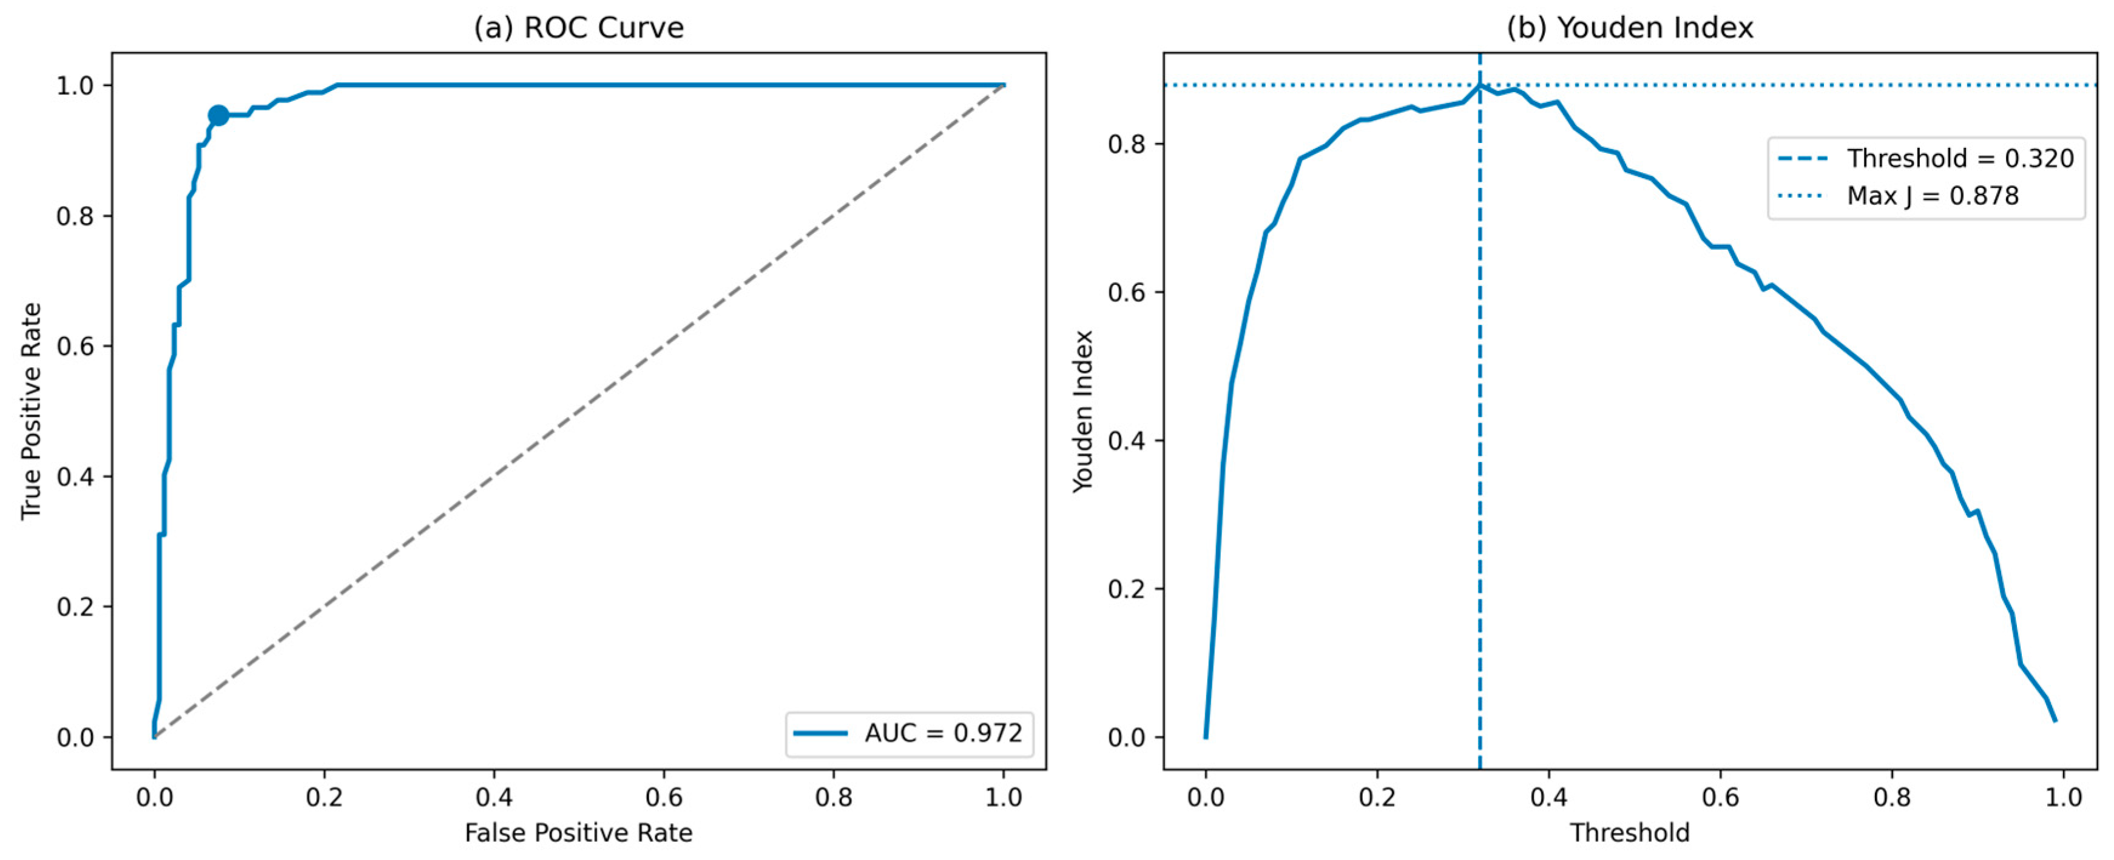
The model reliably separates bloom and non-bloom weeks and identifies a practical alert threshold
Notes:
The left panel tests how well the model separates red tide bloom conditions from non-bloom conditions
A perfect model would go straight up and across the top of the graph.
A random guess would follow the diagonal dashed line.
Our curve is very close to the top-left corner, which means the model is doing much better than guessing.
The curve is close to the top-left corner, and the AUC is 0.972, which is close to perfect.
The right plot asks a practical question: what probability cutoff should we use to issue a bloom prediction?
The best cutoff is about 0.32, meaning that above this probability, the model classifies the week as a bloom.
This gives the best balance between catching true blooms and avoiding false alarms.
Duus 2026 showed that machine learning can forecast red tide conditions.
This work shifts red tide AI from prediction alone toward risk-aware, uncertainty-aware early warning.
This work asks a different question: can we make the forecast more useful for decisions by diagnosing uncertainty, drift, and confidence?

Slide 11
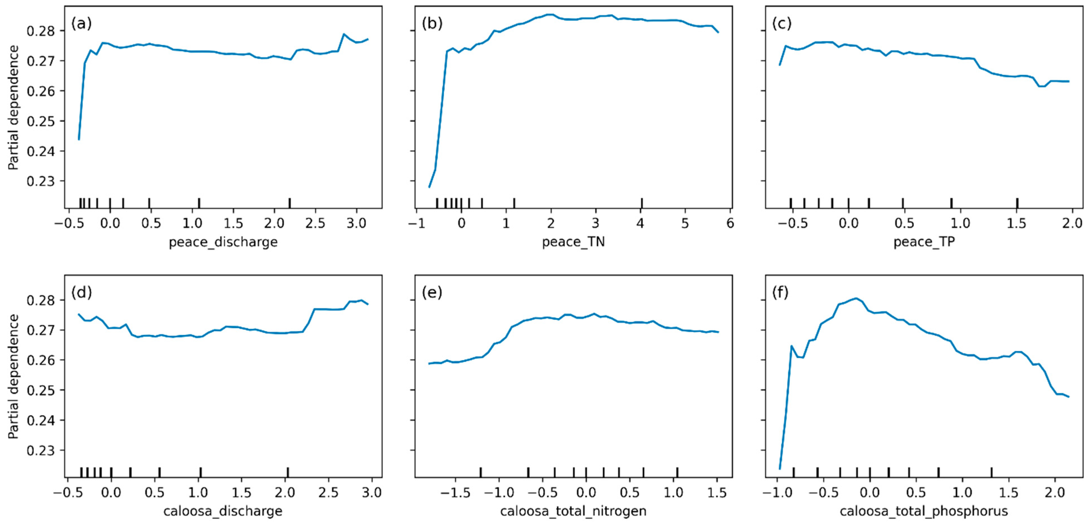
Red tide risk increases nonlinearly and not simply under the highest nutrients
Notes:
Relative predictor value
below typical ← 0 = typical → above typical
The y-axis shows the model’s average predicted probability of a red tide bloom after varying that one predictor while averaging over all other conditions.
Model response curves show nonlinear behavior:
Bloom probability rises with moderate discharge and nutrient loading, then levels off at higher values.
Interpretation:
More water or nutrients does not always mean higher bloom risk; timing, dilution, residence time, and coastal conditions matter.

Slide 12
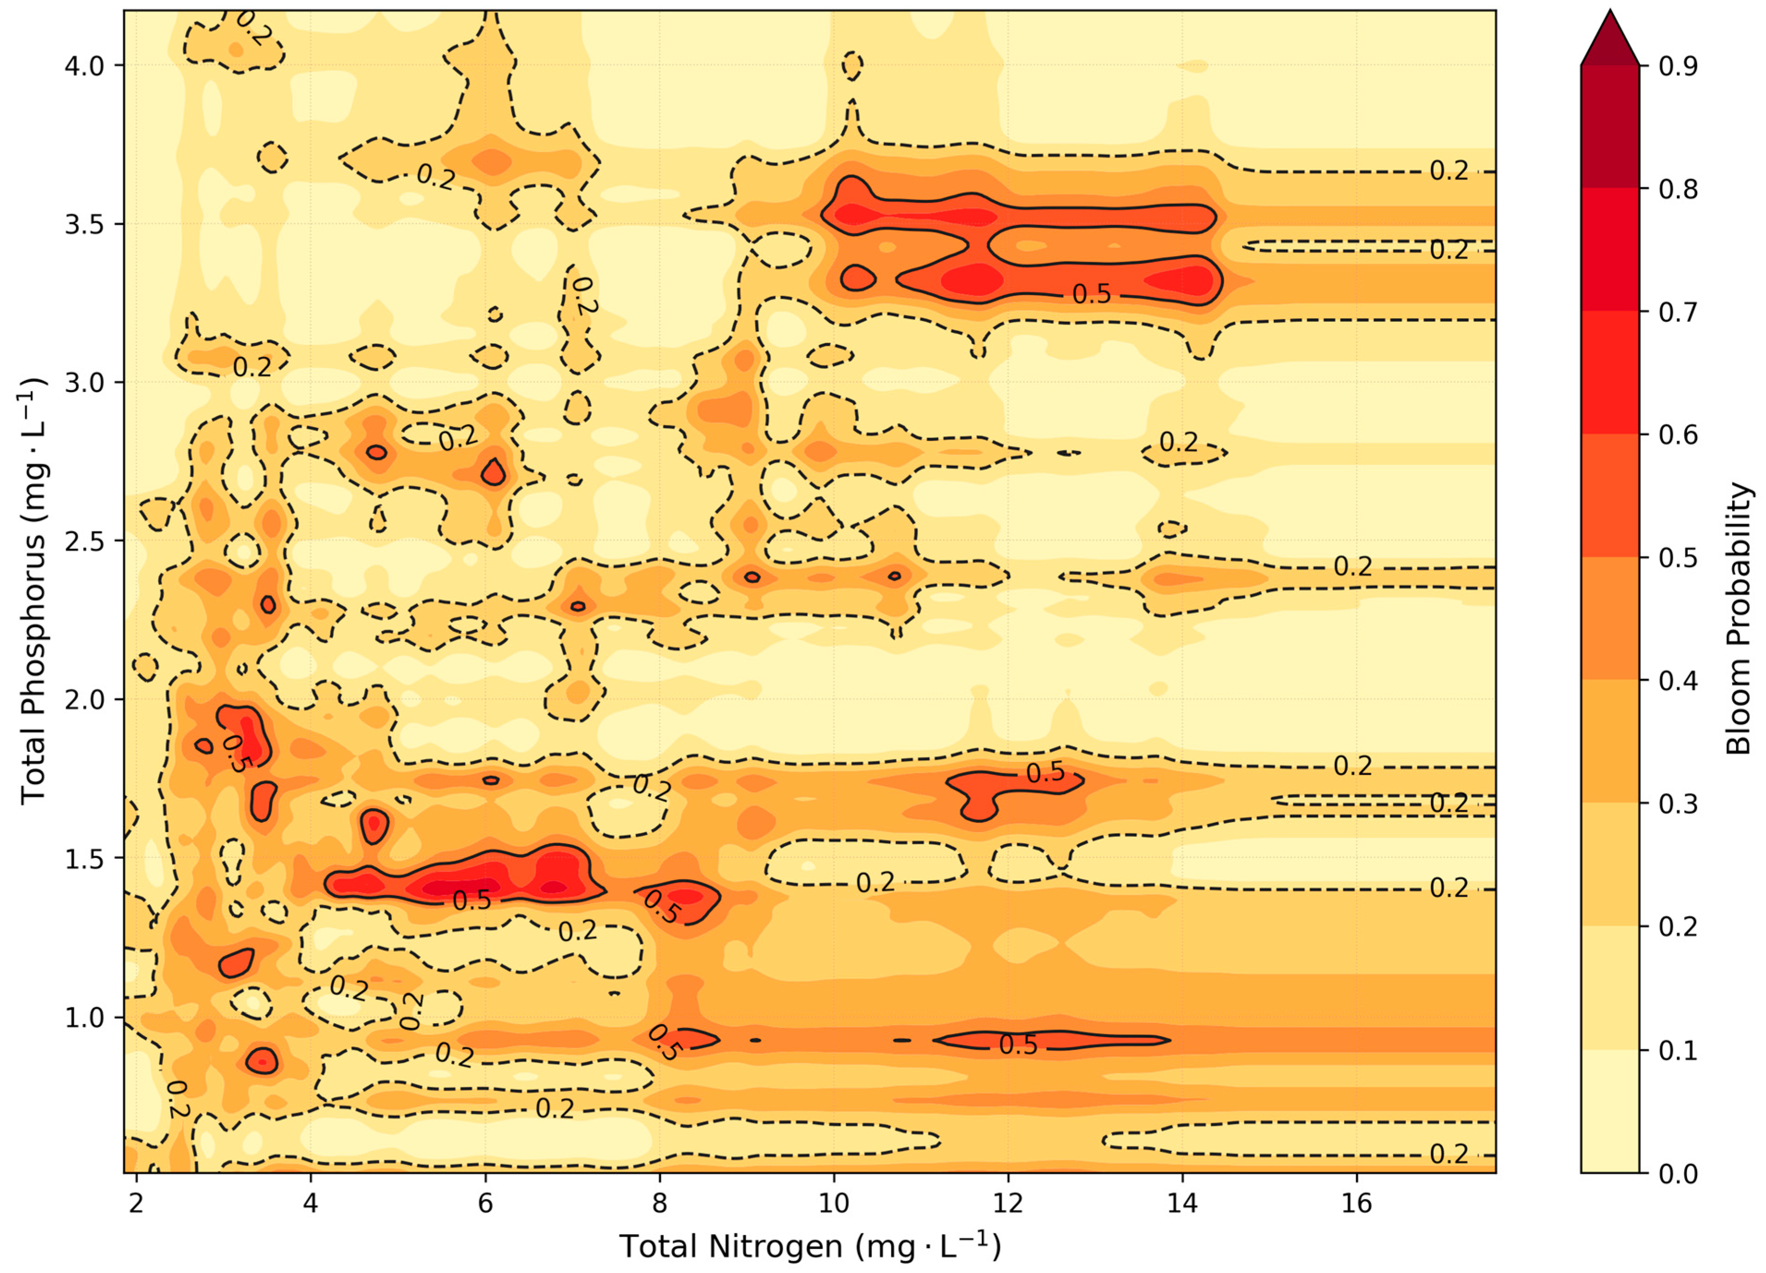
Red tide risk reflects nutrient combinations, not a single nutrient acting alone
Notes:
Two-dimensional partial dependence surface showing modeled K. brevis bloom probability as a function of total nitrogen and total phosphorus;
warmer colors indicate higher bloom probability, and higher probabilities occur where both nutrients are elevated
This figure is the model’s way of saying:
red tide does not seem to care about nitrogen or phosphorus in isolation. It cares about the combination.
Think of it like cooking: nitrogen alone is not the whole recipe, phosphorus alone is not the whole recipe
and unfortunately, the algae are not sharing their cookbook.
But we should be careful: this is a model-derived pattern, not a magic threshold or proof that nutrients alone cause blooms.
This is a model-based response surface, not proof of direct causation.

Slide 13
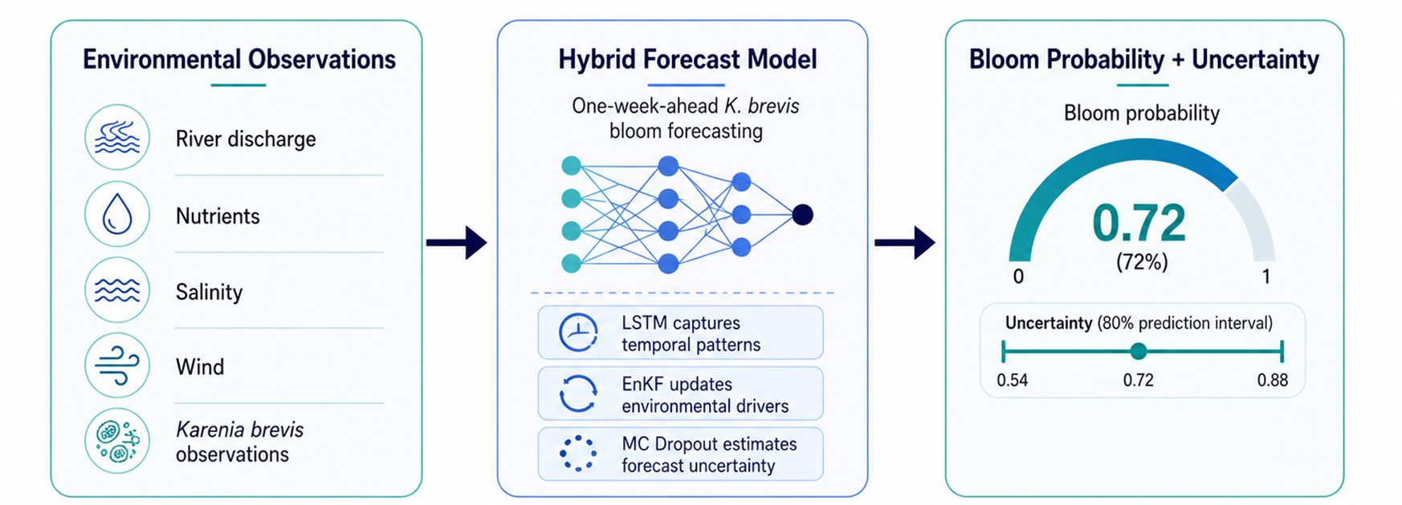
Why accuracy alone is not enough? Early warning needs confidence not just a bloom or no-bloom label
Notes:
After showing that machine learning can forecast red tide, the next question is not only whether the model is right, but whether we know when to trust it.
The study uses a hybrid LSTM–EnKF–MC Dropout framework for one-week-ahead K. brevis bloom forecasting,
where EnKF updates environmental drivers before LSTM prediction and MC Dropout provides uncertainty at each forecast step
This suggest shorter period for assimilation like daily

Slide 14
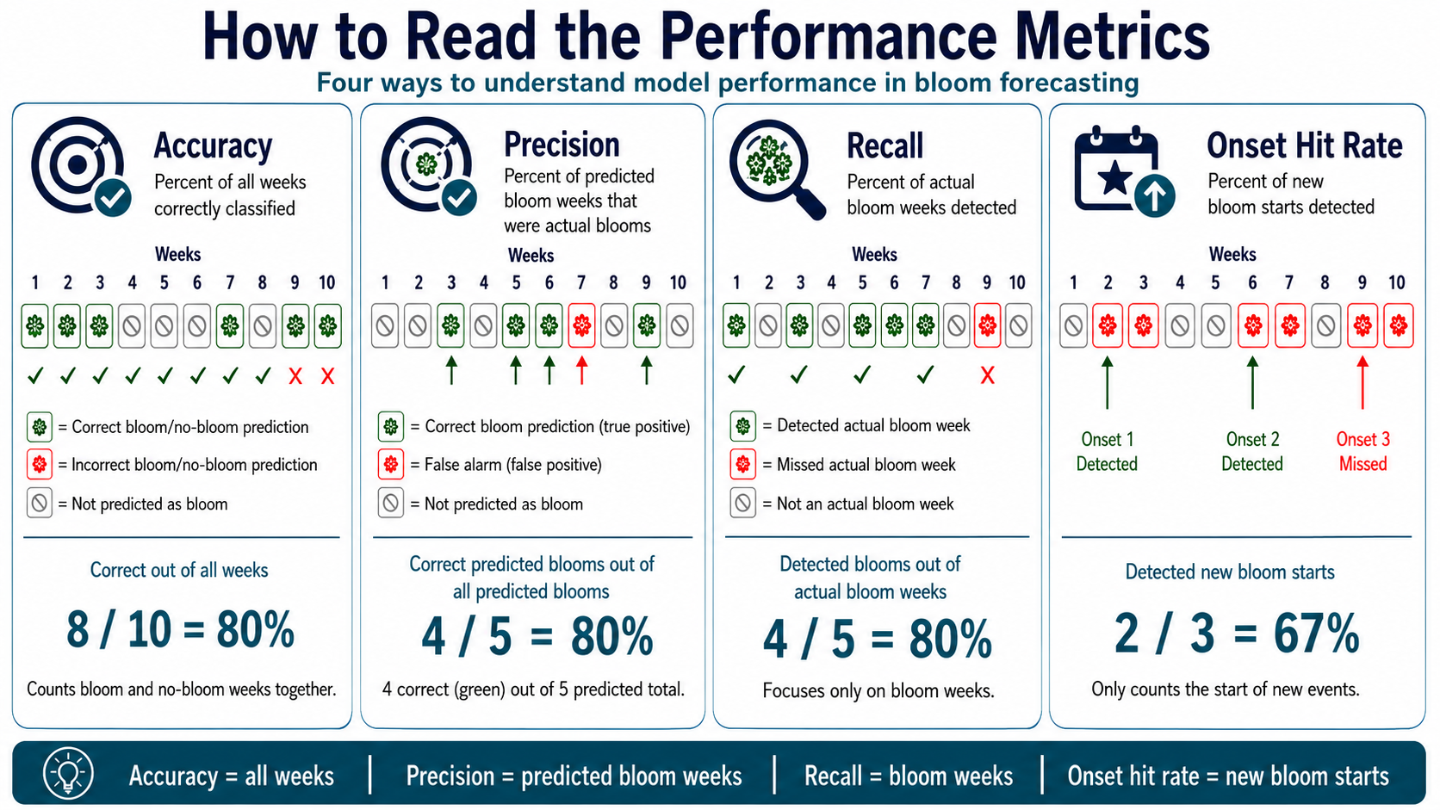
The hybrid model performs similarly to LSTM but adds uncertainty information
Higher onset detection can come at the cost of more false alarms
Model | Accuracy | Precision | Recall | Onset hit rate
Logistic regression | 85.2% | 71.4% | 92.1% | 70%
Standalone LSTM | 91.7% | 87.0% | 88.2% | 30%
LSTM–EnKF | 90.9% | 84.8% | 88.2% | 40%
ChatGPT 5.5 Generated Iamge
Notes:
We should not oversell the hybrid as simply ‘more accurate.’
It is not statistically better than the LSTM on aggregate metrics.
Its value is that it gives us probability, uncertainty, and confidence diagnostics.
Takeaway: Logistic regression catches more bloom onsets, but the LSTM-based models provide stronger overall classification and uncertainty-aware forecasting.
The manuscript reports overlapping confidence intervals between the standalone LSTM and LSTM–EnKF on aggregate metrics,
meaning no statistically distinguishable performance difference at this test-set size.
It also notes that logistic regression achieved higher onset detection, but at lower precision, illustrating a precision–sensitivity tradeoff.

Slide 15
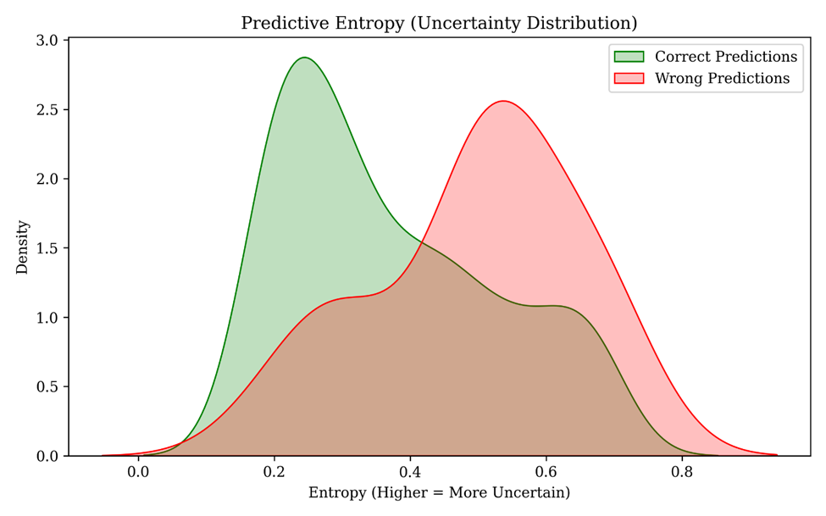
Uncertainty rises during bloom transitions: Onset and decay
Notes:
The model is most confident when conditions are clearly bloom or clearly non-bloom.
It becomes less confident during the transition periods when a bloom is starting or fading, which are exactly the moments when managers most need guidance.
Weekly updates are useful, but not enough to remove forecast lag.
Figure 8 or a simplified cartoon of “forecast lags behind bloom onset.”
Lag −1 residual structure remains
Weekly assimilation does not fully remove delayed response
Future direction: daily or semi-weekly updates with physics-informed propagation
Speaker point:
“The model still has a one-week reactive tendency. That is not a failure; it tells us what the next generation needs: higher-frequency data and a better propagation model.”
The manuscript concludes that the Lag −1 residual peak persists under weekly assimilation and that resolving it would require daily or semi-weekly assimilation with a physics-informed or data-driven propagation model.

Slide 16
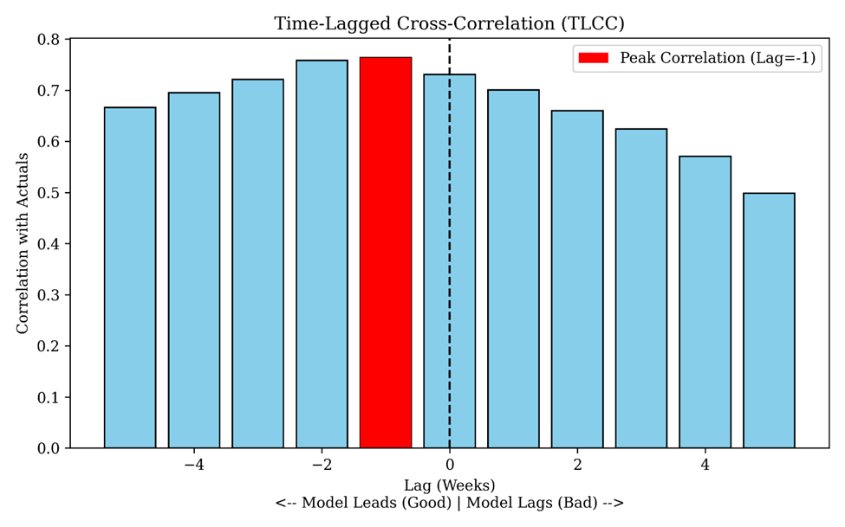
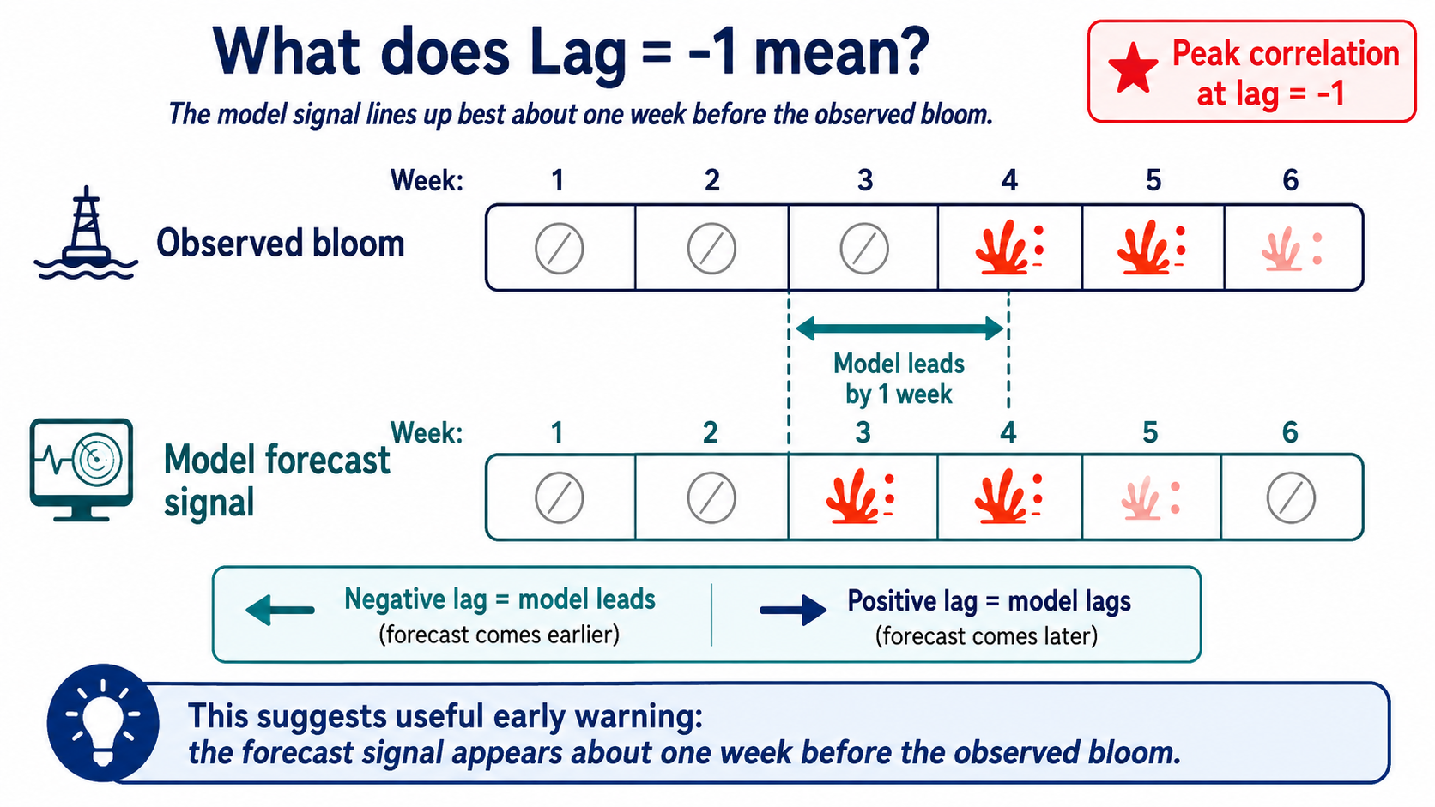
The model shows a useful one-week early signal, but persistence means timing should be interpreted cautiously
ChatGPT 5.5 Generated Iamge
Notes:
This plot is a timing check. We are asking: when do the model signal and the observed bloom pattern line up best? The highest bar is at Lag −1.
Under this lag convention, that means the model signal appears about one week before the observed bloom.
That is encouraging, because early warning is exactly what we want. But notice the nearby bars are also high,
so the model is not a crystal ball — it is more like a very cautious friend saying,
‘Something may be starting next week… maybe bring your inhaler and don’t plan the beach wedding yet.’”

Slide 17
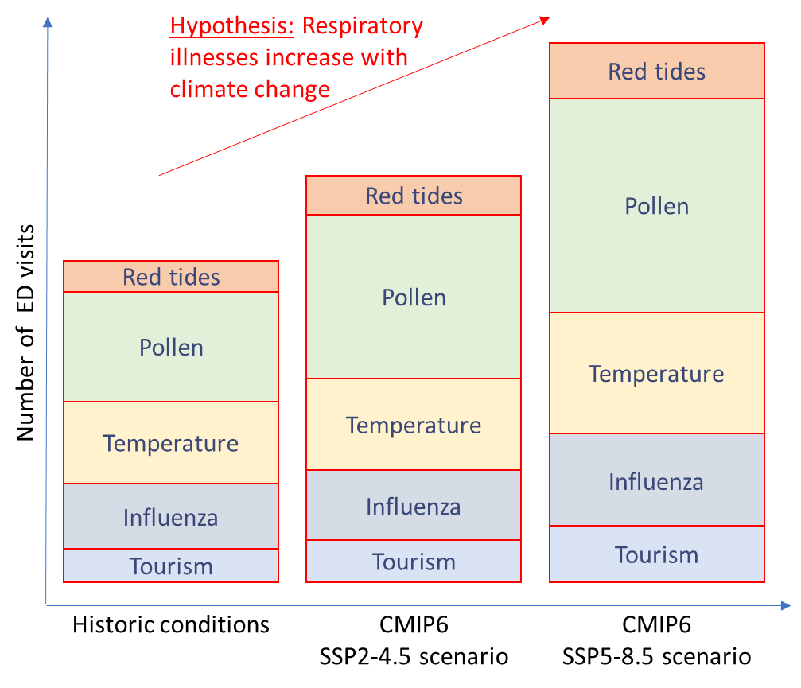
Data-model framework of predicting and mitigating red tide health impacts under climate change
Rask 1. Collect and analyze of ground-based and remote sensing data on red tide event, and red tide public health data
Red tide event data
Task 2. Develop machine learning models for predicting red tide events based on climate and environmental drivers
Red tide event machine learning models
Red tide public health data
Task 3. Develop Earth system model ensemble to project red tide events under different climate scenarios using ML models
Red tide event future projections
Task 4. Model future health impacts of red tides by linking red tide projection to respiratory health outcomes under different climate scenarios
Red tide public health future projections
Task 5. Develop public health mitigation strategies through integration and stakeholder engagement
Notes:
Task 1. Comprehensive database of red tides and public health
Task 2. Conceptual models for global warming and geohealth drivers of red tide events
Task 3. ESM ensemble for land–ocean–global warming dynamics and red tide projection using ML
Task 4. Health impact modeling by linking red tides to respiratory health outcomes
Task 5. Integration and stakeholder engagement for public health mitigation strategies

Slide 18
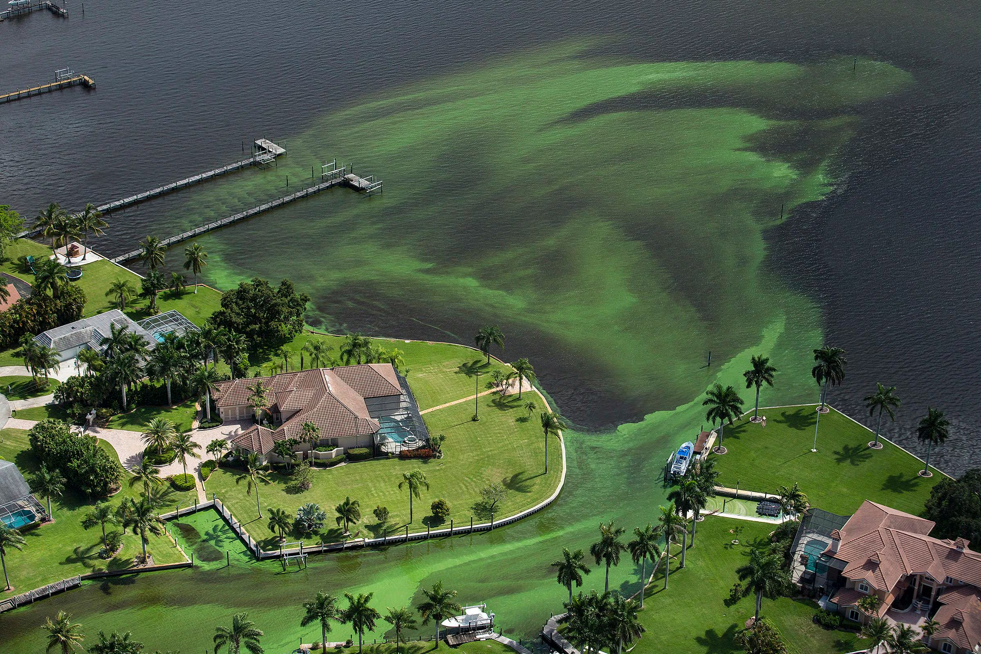
Spatiotemporal deep learning as a screening tool, not a definitive bloom predictor
St. Lucie River in Stuart (Greg Lovett, AP)
Notes:
For blue-green algae in the Caloosahatchee system, AI is useful only when it respects the spatial movement of water
but the model should be used as a conservative screening layer, not as an automatic forecast.

Slide 19
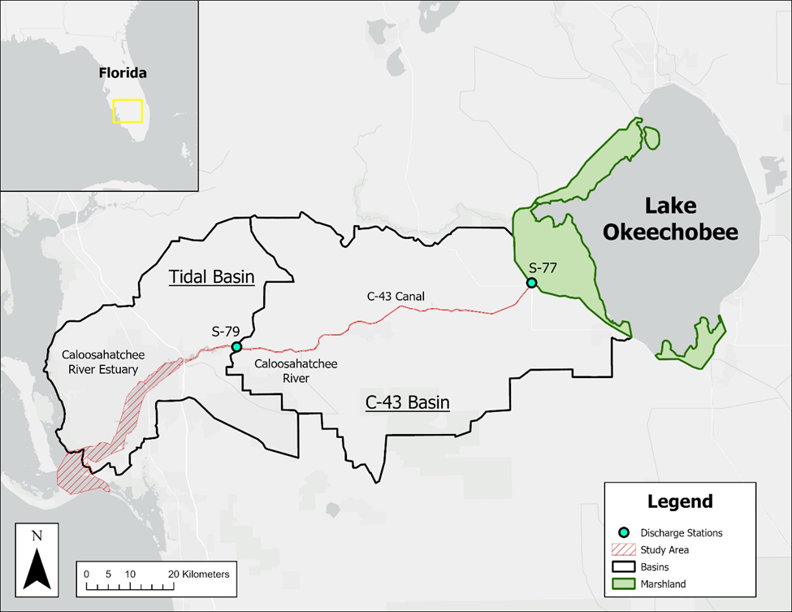
Managed freshwater releases create delayed, spatially distributed bloom risk
Notes:
Lake Okeechobee → S-77 → C-43 Canal → S-79 → Caloosahatchee River Estuary
Lake Okeechobee releases
C-43 / Caloosahatchee transport→ Downstream spectral bloom indicators
Can satellite imagery + discharge history screen for downstream bloom risk?
- Blooms are not just “here and now” they reflect transport, lag, mixing, clouds, optical uncertainty, and estuarine complexity.
The manuscript frames the system as a regulated river–estuary
where managed Lake Okeechobee discharges pass through S-77 and S-79 into the Caloosahatchee River Estuary,
and the study specifically asks whether lagged discharge contains useful signal for downstream bloom indicators.

Slide 20
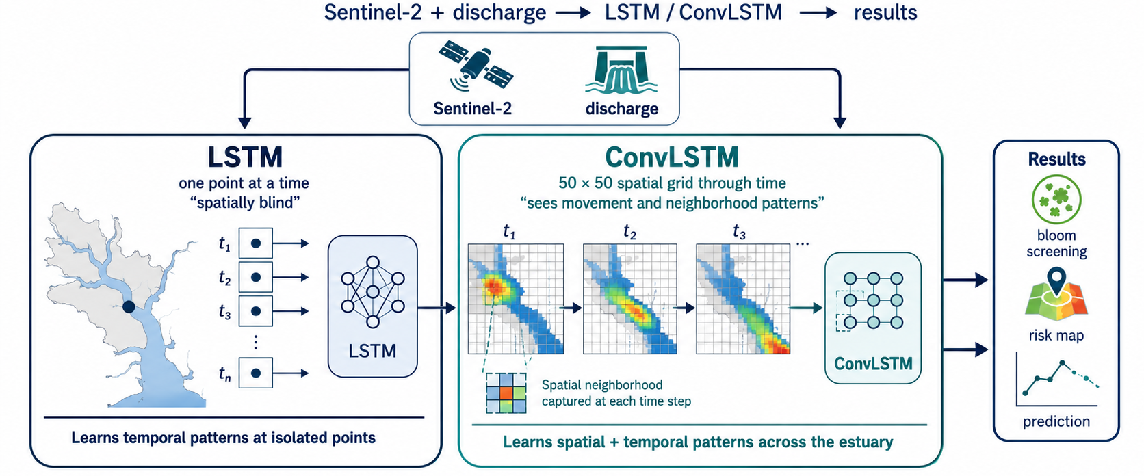
A spatially blind model misses the estuary so ConvLSTM treats it like a moving water-quality movie
Notes:
On the left, the LSTM model looks at one location at a time. It can learn how conditions change through time at that point, but it does not really know what is happening upstream, downstream, or in neighboring areas. That is why we call it ‘spatially blind.’ For a system like the Caloosahatchee, that is a major limitation, because bloom indicators and water-quality signals can move with discharge, mixing, and plume transport.
On the right, the ConvLSTM treats the estuary more like a short movie. Instead of seeing one point at a time, it sees a spatial grid through time.
So it can learn not only whether conditions are changing, but also where those changes are moving.
Conceptually, this is important because plume movement and advective transport are spatial processes. A model that cannot see spatial neighborhoods may miss the way a signal propagates from Lake Okeechobee, through the C-43 canal, and toward the estuary.
The key takeaway is not that ConvLSTM is magically better.
The key takeaway is that the model architecture has to match the environmental process.
For this system, a moving water-quality problem needs a model that can see movement.
The manuscript describes the LSTM as treating the 5,000 sampling points as independent time series, while the ConvLSTM converts those points into a 50 × 50 spatial grid through time to capture neighborhood effects,
plume movement, and spatial propagation of spectral anomalies.

Slide 21
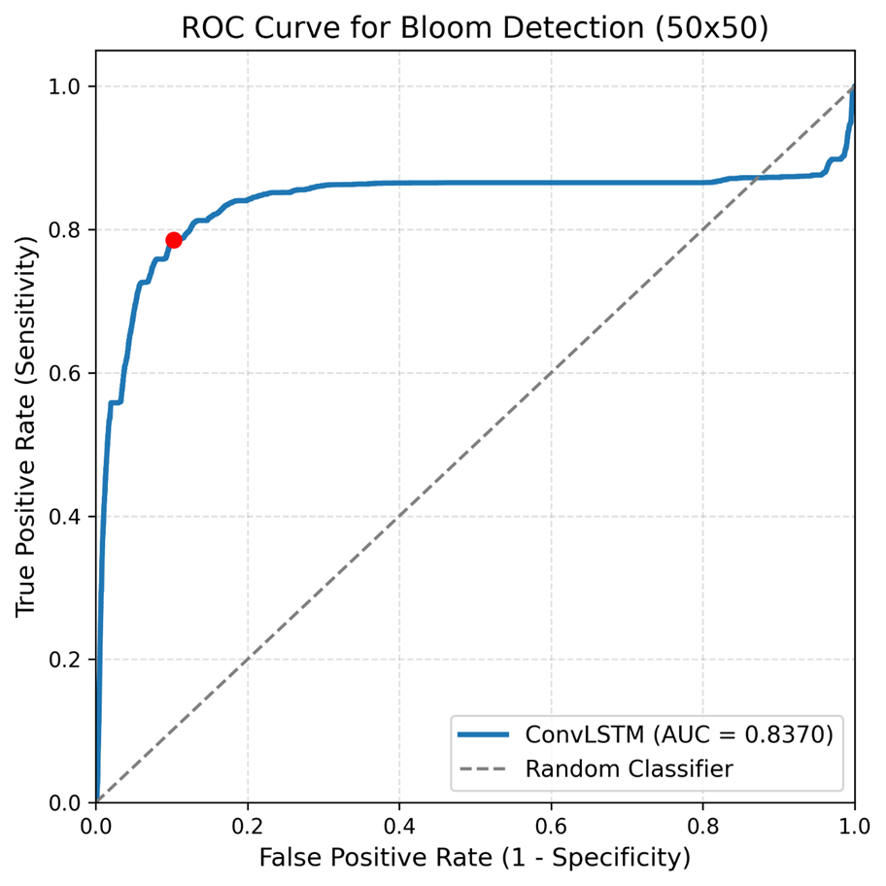
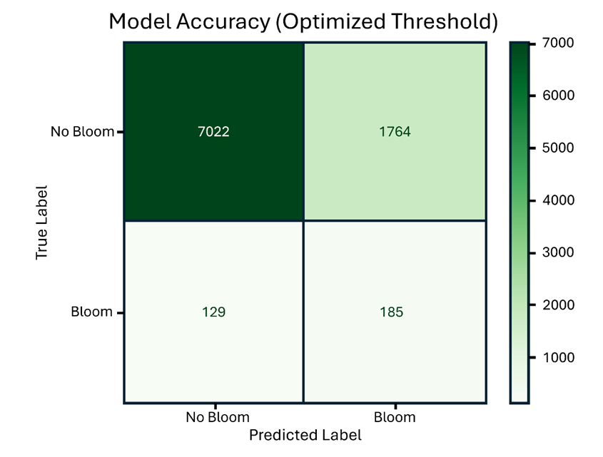
ConvLSTM can screen for elevated bloom risk, but it is not precise enough to act alone.
ConvLSTM screening performance
AUC = 0.837 → better than random screening
Recall = 58.9% → detects many bloom-like events
Precision = 9.5% → many alerts are false positives
Best use: guide monitoring, not automatic action
Notes:
This slide is the honest result of the ConvLSTM model.
Left Figure shows that the model does have discriminatory skill.
- The ROC curve is well above the random line, and the AUC is 0.837, so the model is learning useful spatial–temporal information from Sentinel-2 and discharge history.
Right Figure 10 tells us how that skill translates operationally. At the optimized threshold, the model detected 185 out of 314 actual bloom cases, which gives a recall of about 59%.
- That is useful for screening because it means the model catches many potential bloom-like conditions.
- The problem is precision. The model also produced 1,764 false alarms, so only about 9.5% of its bloom alerts were actual bloom cases.
- In other words, this is not a model you would use to automatically declare a bloom.
The right interpretation is that ConvLSTM is a conservative screening tool.
- It helps narrow the search space and point managers toward times and places where additional monitoring may be warranted.
- But it still needs human judgment, field observations, and follow-up verification.”
So, the takeaway is: the model sees useful spatial–temporal risk patterns,
but responsible use means treating its output as an early screening signal, not a final decision.

Slide 22
Human-Centered AI for South Florida Waters
From water data to insight and decision support
Human-centered AI asks: Who uses data? Who is affected? What remains uncertain?
Notes:
Human-centered AI is not just about better algorithms;
It is about designing tools that help people make water decisions under uncertainty.
Human-centered AI asks: Who uses data? Who is affected? What uncertainty remains and how to communicate uncertainty

Slide 23
Nature-based Infrastructure for Enhancing Climate Resiliency of Groundwater Resources in South Florida
Assess climate change impacts
Evaluate nature-based infrastructure for mitigation (local or regional)
Collaborative modeling
Web-based platform for data sharing
Groundwater education and outreach
Notes:
Quantifying the impacts of climate change on surface-groundwater interactions, groundwater resources, water quality in terms of salinity (undergoing). This is particularly related to the changing rainfall pattern and SLR rise under different scenarios
Collaborating with stakeholders to evaluate nature-based infrastructure for mitigation and adaptation solutions (Next step). This could be at local or regional scale (any suggestion on this would be also appreciated)
Conducting outreach campaigns to increase community awareness about the resilience of groundwater resources in South Florida (using different outlet medias).
Developing a user-friendly web-based platform to provide stakeholders with access to project data, supporting decision-making and community engagement. This helps to the goal of making data FAIR: Findable, Accessible, Interoperable, and Reusable

Slide 24
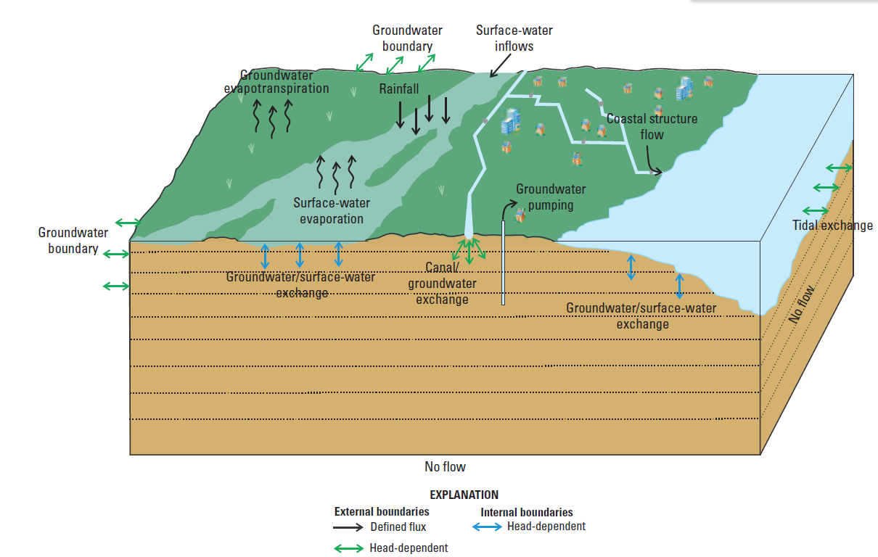
Project assesses climate change impacts and mitigation measures using numerical models
Slough
Biscayne and Southern Everglades Coastal Transport (BISECT) model (Swain, et al. 2019, USGS)
Notes:
Conceptual model of the hydrologic system of the Biscayne and Southern Everglades Coastal Transport (BISECT) model (Swain et al., 20219)

Slide 25
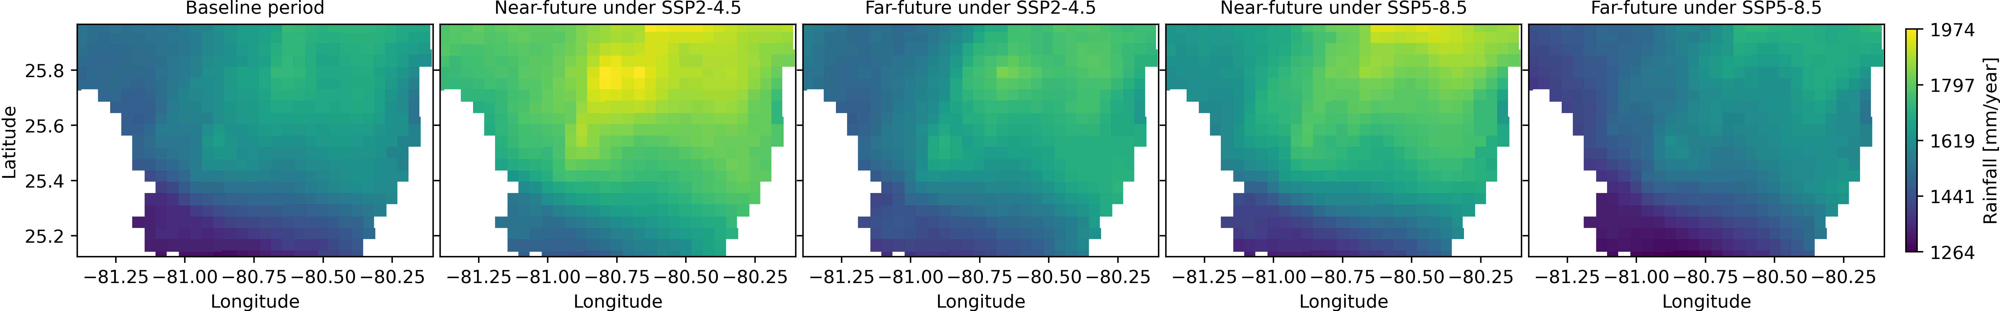
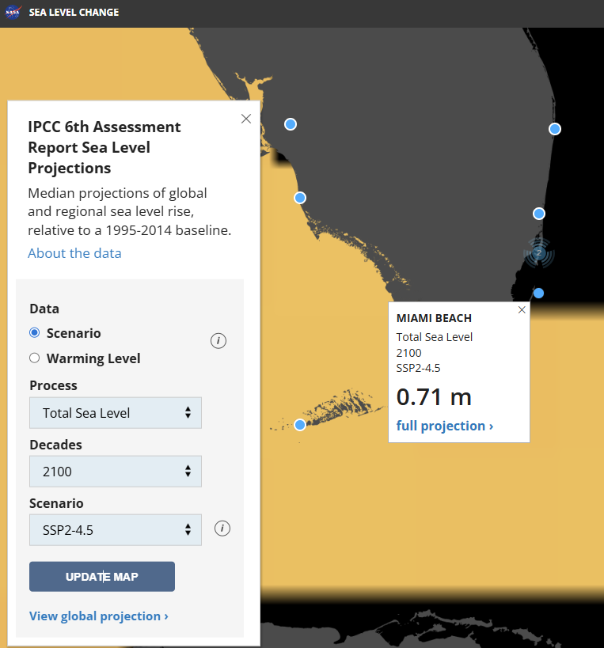
Model Inputs include climate projections with baseline and future temporal coverage
Rainfall, CMIP6 - Oak Ridge National Laboratory
Sea-level Rise, CMIP6 - NASA
Notes:
NetCDF data
Intergovernmental Panel on Climate Change (IPCC) Sixth Assessment Report (AR6)
Downscaled CMIP6 climate projections
SSP2-4.5 and SSP5-8.5 scenarios
NASA projections
Temporal Coverage
Baseline: 2011–2019
Near-future: 2051–2059
Far-future: 2091–2099

Slide 26
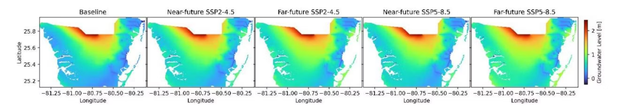
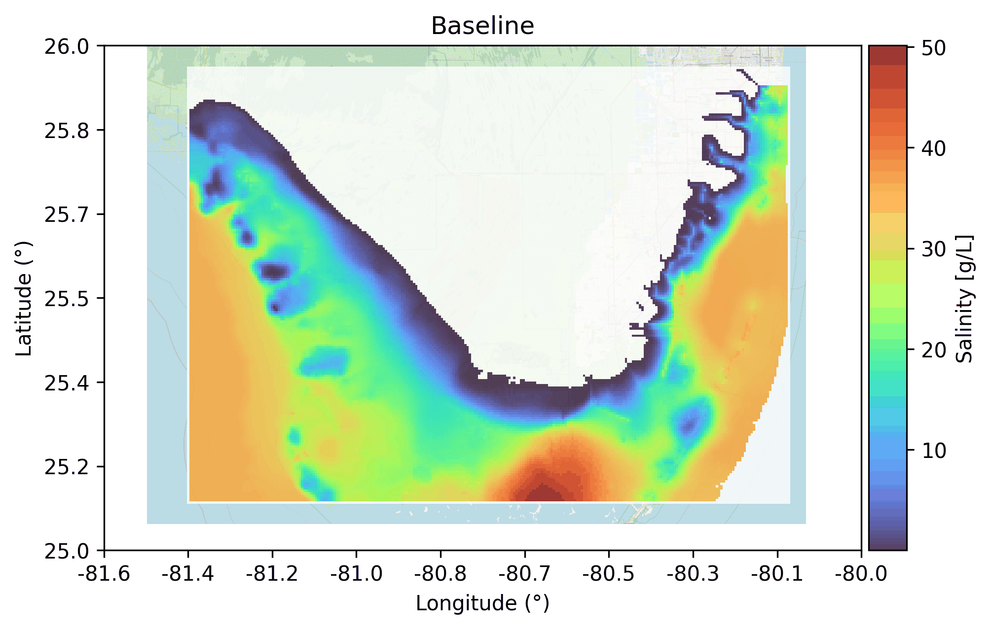
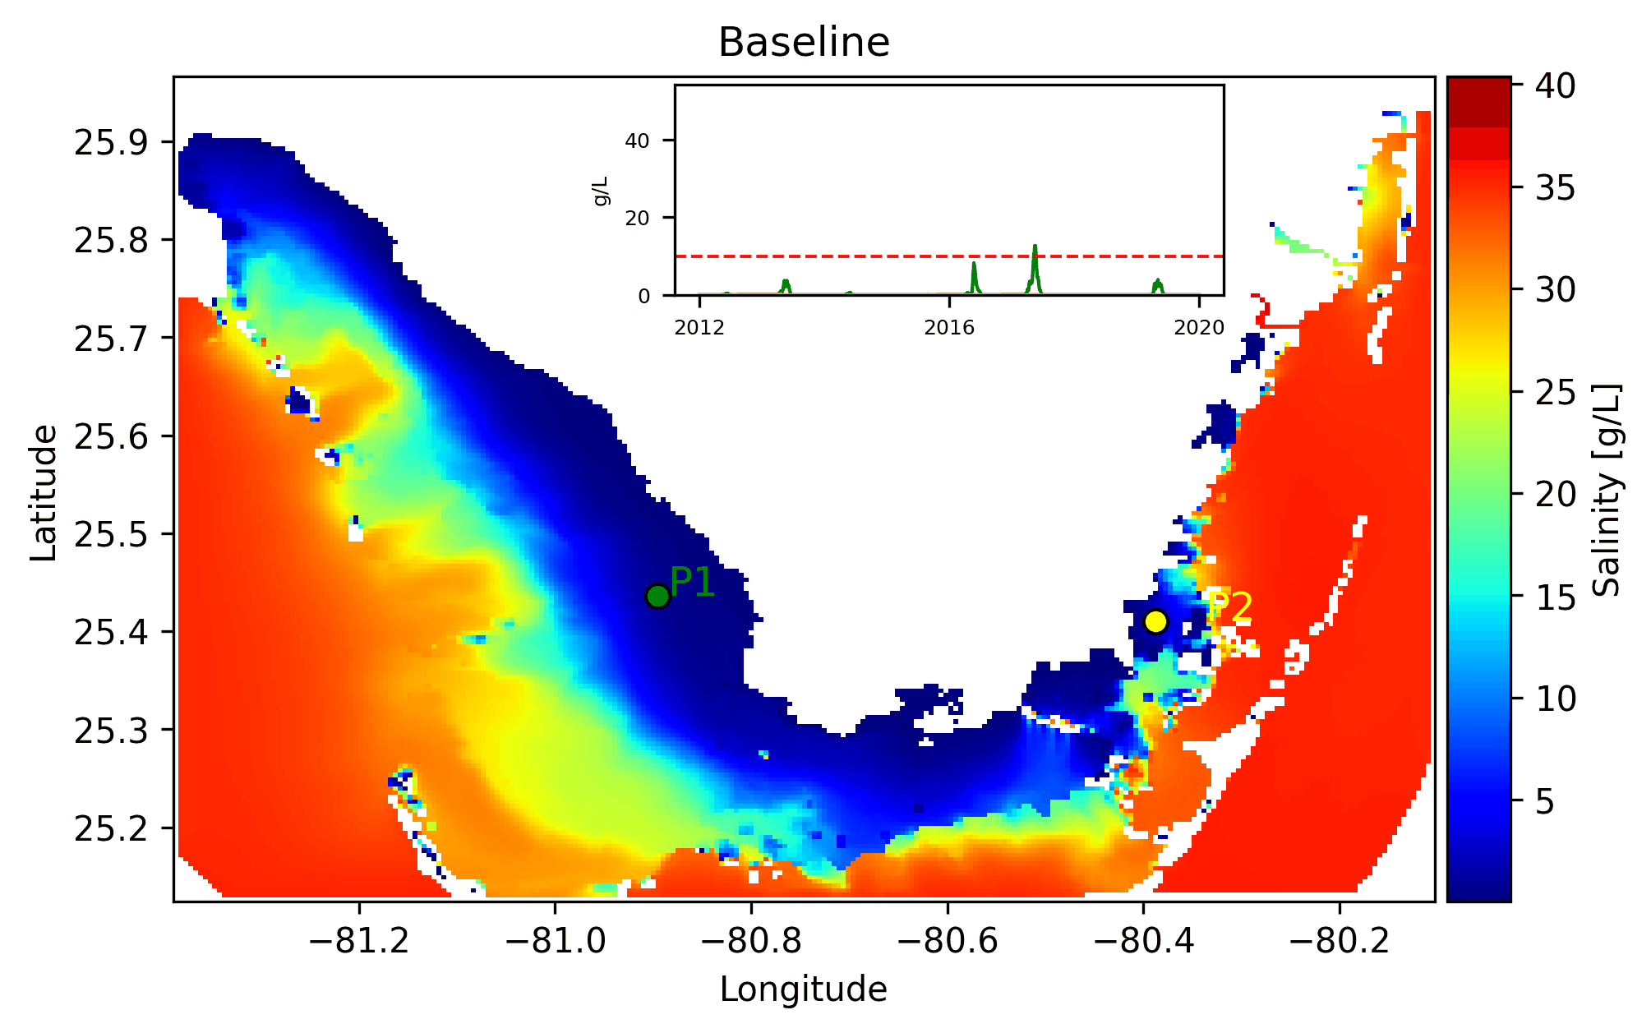
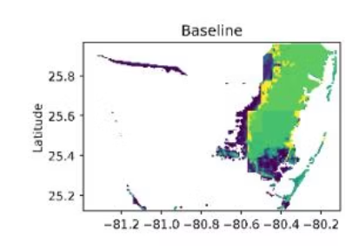
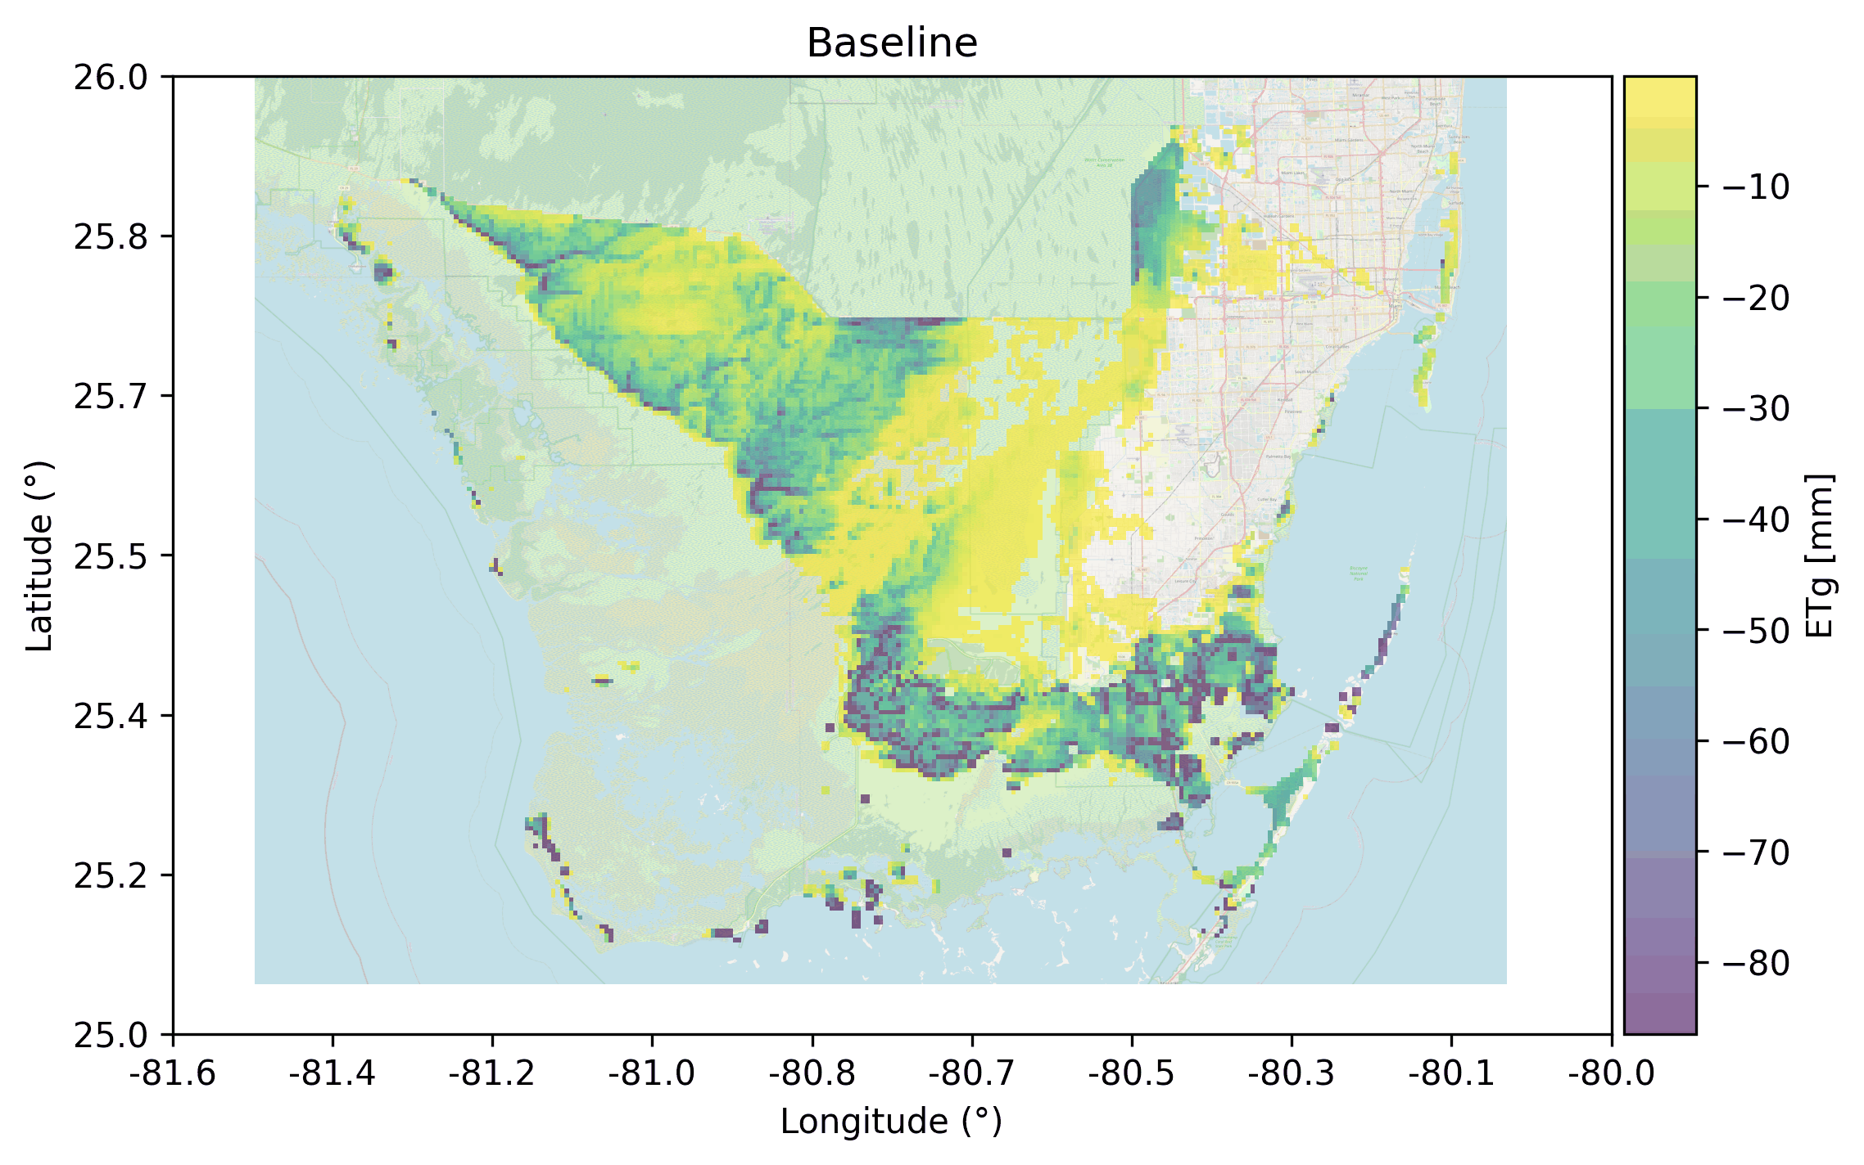
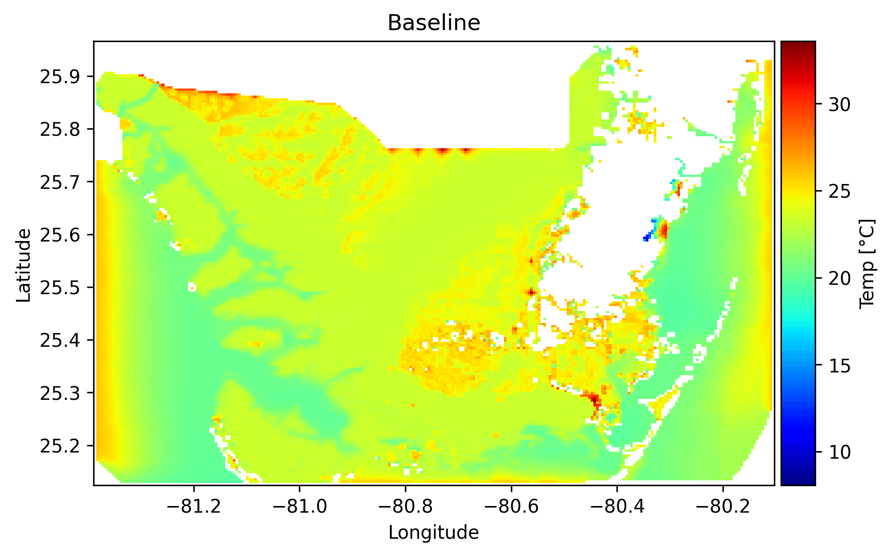

Model outputs are critical for diverse stakeholders at South Florida
Groundwater Levels
Groundwater Salinity
Surface-water Salinity
Groundwater Recharge
Evapotranspiration
Surface-water Temperature
Notes:
Model Outputs (different data formats)

Slide 27
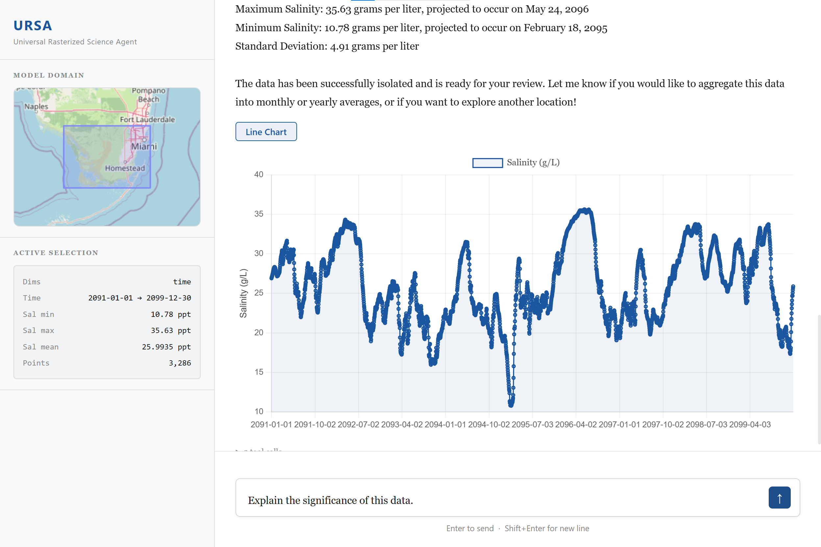
LLM for open environmental data
Implementing a chat-style interface for regional water data.

Slide 28
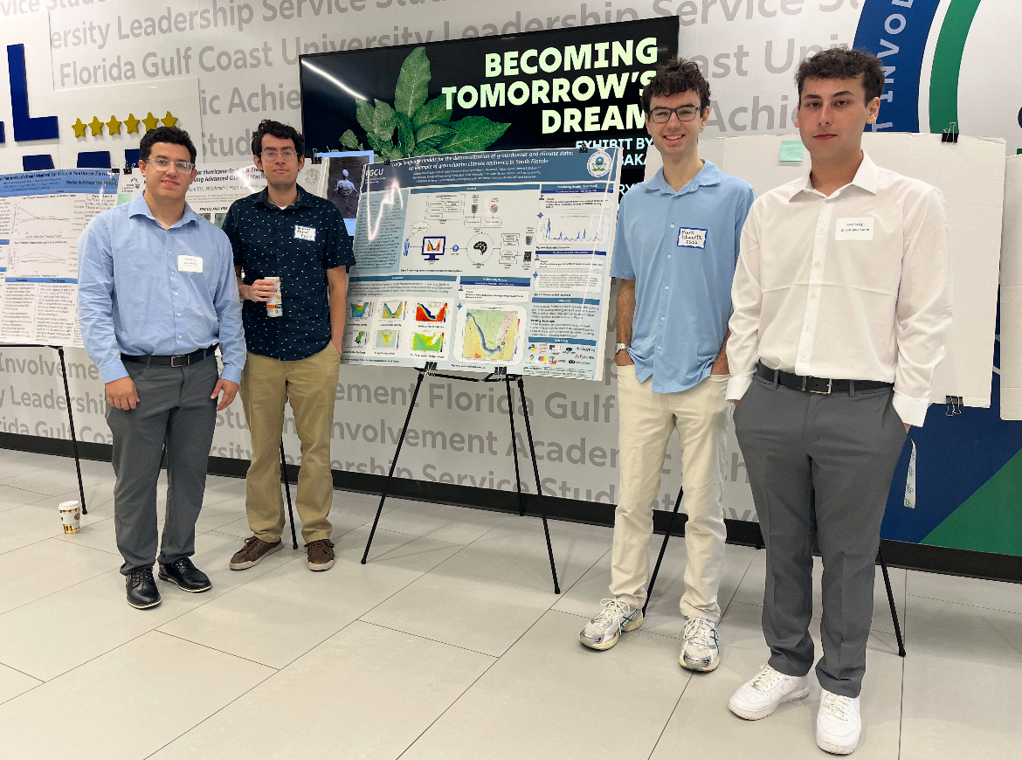
SWFL Water Resources Conference
Research team: Michael Alvear, Luis Cabrera, Mark Schwartz, Christopher Smith

Slide 29




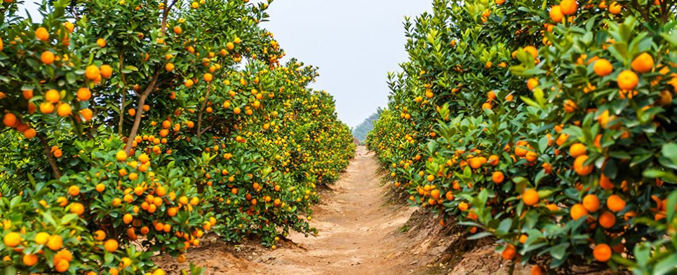

Motivation
Data
General Public
Technical Barrier
Sources: nasa.gov, noaa.gov, copernicus.eu, Microsoft

Slide 30
Exploring LLMs as Epistemic Mediators of Data

Slide 31
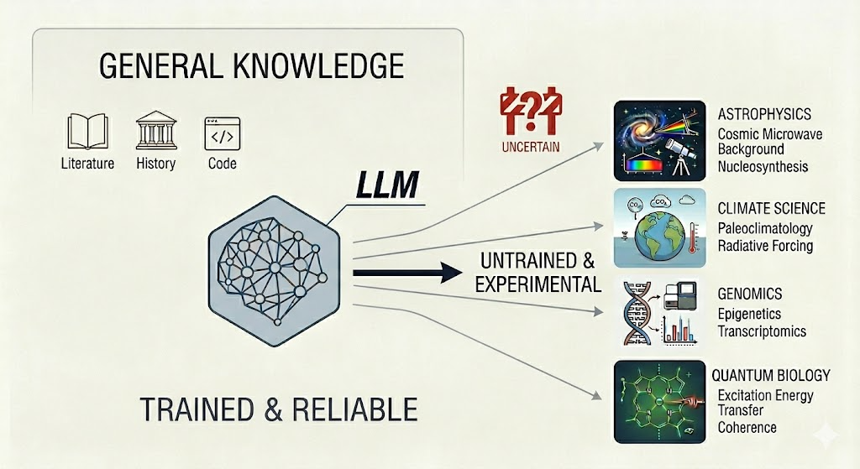
Source: Gemini 3 Flash

Slide 32
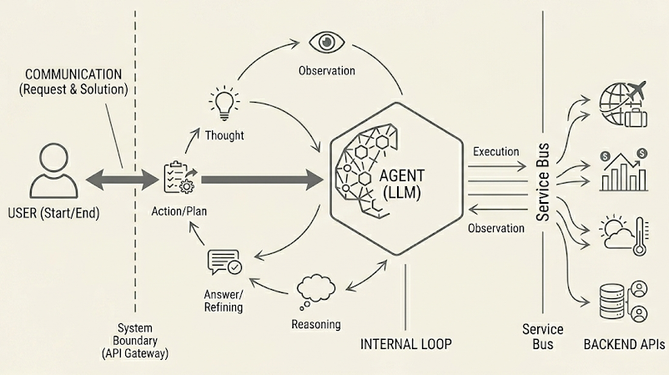
AI Agents: a Collection of Interfaces for an LLM
Generated by Gemini 3 Flash

Slide 33
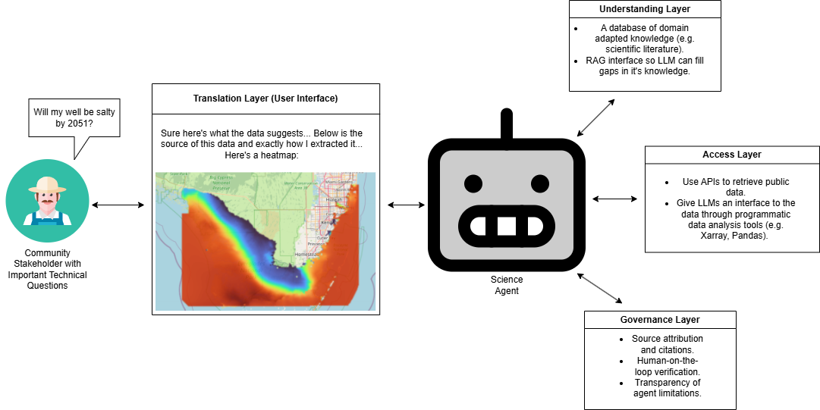
We propose a four-layer framework for a general science agent:

Slide 34
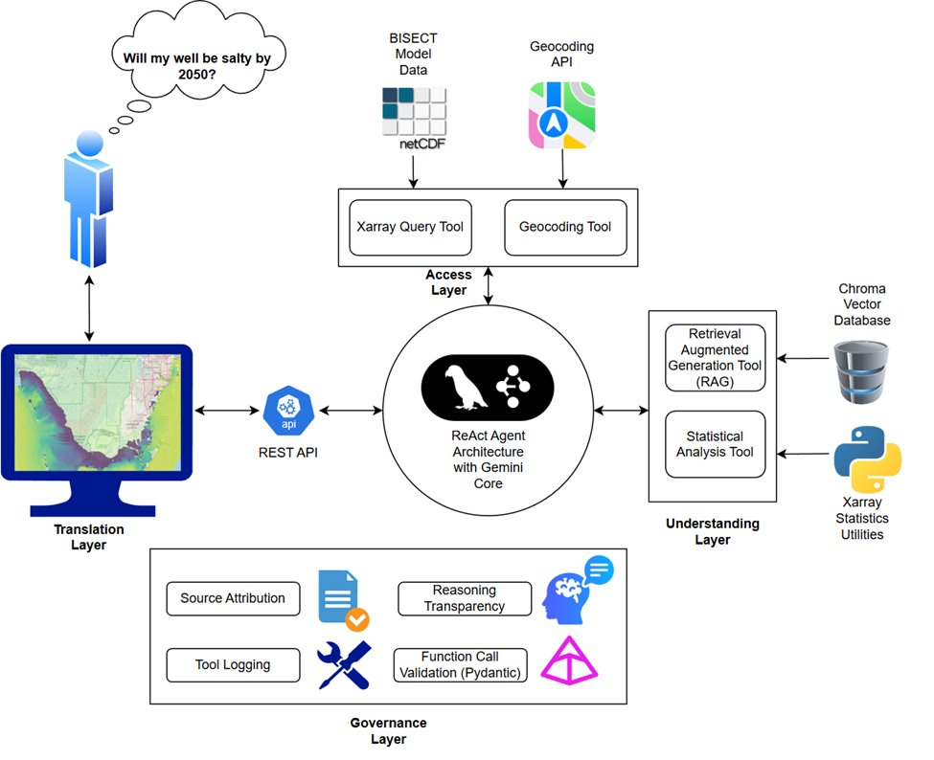
Let's Test the Framework by Implementing an AI Agent to Communicate Regional Water Data.

Slide 35
Access Layer
(How did we make a geospatial data interface?)

Slide 36
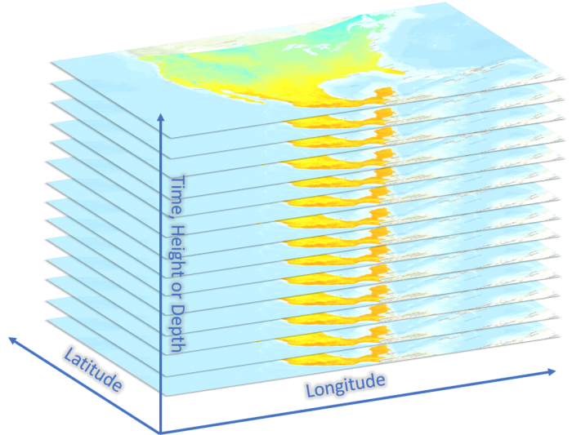
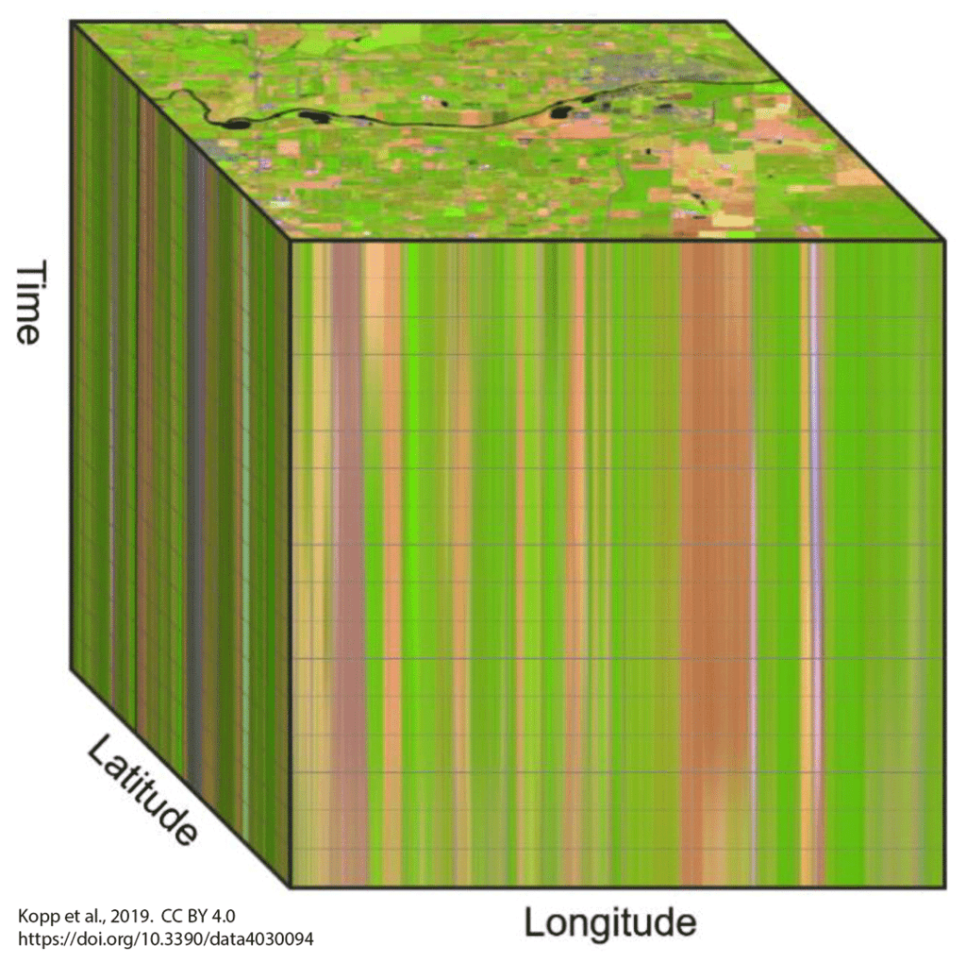
What Does our Data Look Like?
Source: esri.com

Slide 37
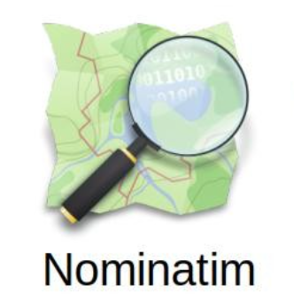
Our GIS Tool Suite
Sources: xarray.dev, openstreetmap.org

Slide 38
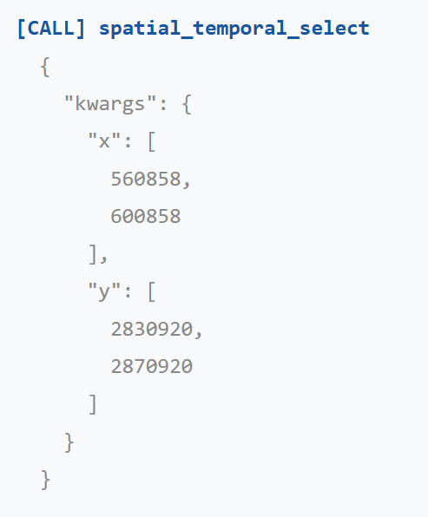
Spatial Temporal Select

Slide 39
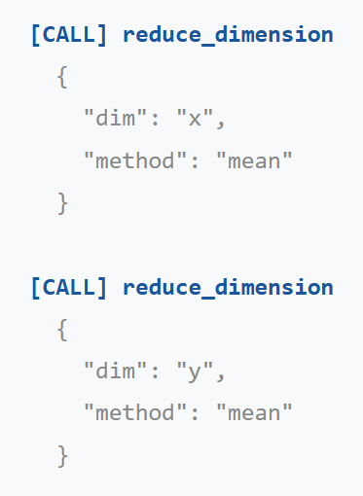
Reduce Dimension

Slide 40
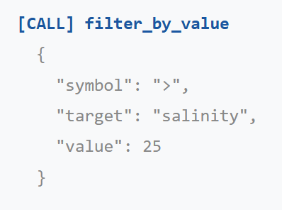
Filter by Value

Slide 41
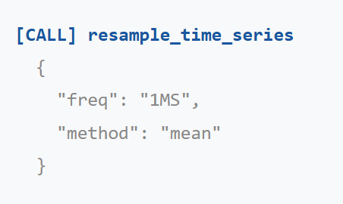
Resample Time Series

Slide 42
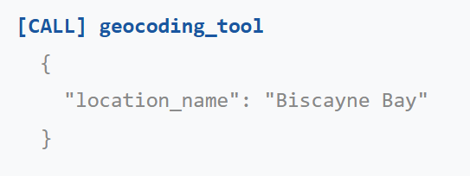
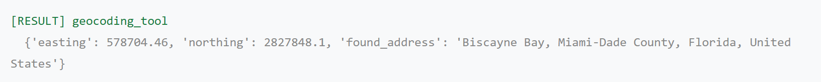
Geocoding

Slide 43
Understanding Layer
(How to expand domain knowledge?)

Slide 44
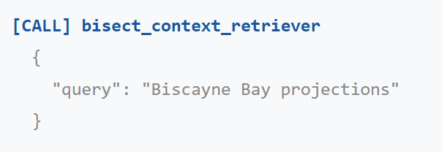
RAG Tool

Slide 45
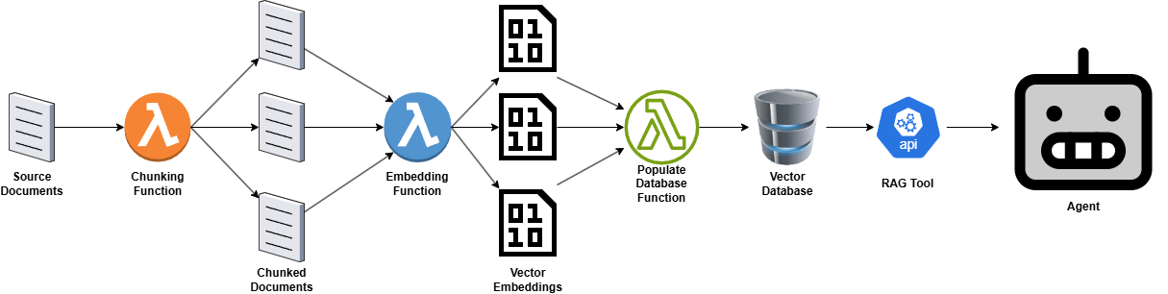
RAG Pipeline

Slide 46
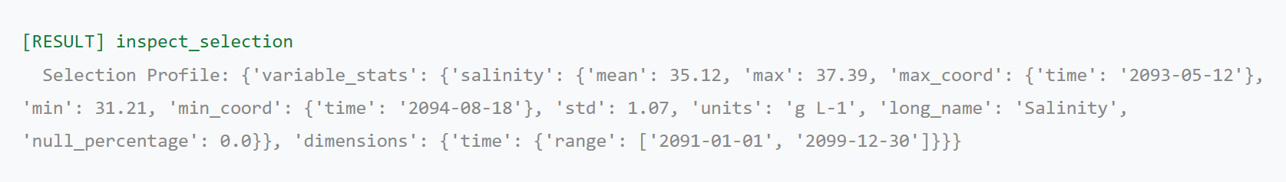
Inspect Selection

Slide 47
Translation Layer
(How to present results?)

Slide 48

GUI

Slide 49
Governance Layer
(How to mitigate mistakes?)

Slide 50

Human on the Loop
Source: cloudflare.com

Slide 51


Slide 52


Slide 53



Challenges + Next Steps

Slide 54

Q&A + Demonstration
Questions, comments, concerns?

Slide 55


Thank You
Questions?
Human-centered AI helps people interpret complex water data, understand uncertainty, and decide what to check or do next
AI can flag HAB risk earlier, but uncertainty and false alarms require monitoring and expert review
LLMs make model outputs easier to access, but trusted use requires sources, governance, and human review

